Slide 1
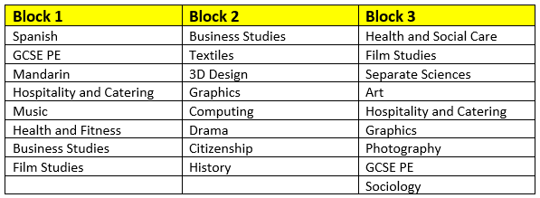
Year 9 Pathways
Welcome to Art & Photography

Slide 2


Which Subjects do we offer?
GCSE ART & DESIGN
GCSE PHOTOGRAPHY

Slide 3



Which topics do we teach
GCSE ART:
YEAR 10 -STRUCTURES – NATURAL (Workshop based, printmaking, 3D)
YEAR 10 - STRUCTURES – MAN MADE
YEAR 10 - HUMAN
YEAR 10/11- INDEPENDENT PROJECT
YEAR 11 -EXTERNALY SET ASSIGNMENT
GCSE PHOTOGRAPHY:
YEAR 10 - PORTRAITURE GENRE
YEAR 10 - ARCHITECTURE GENRE
YEAR 10 - ABSTRACT GENRE
YEAR 10/11 - INDEPENDENT PROJECT
YEAR 11 – EXTERNALLY SET ASSIGNMENT

Slide 4
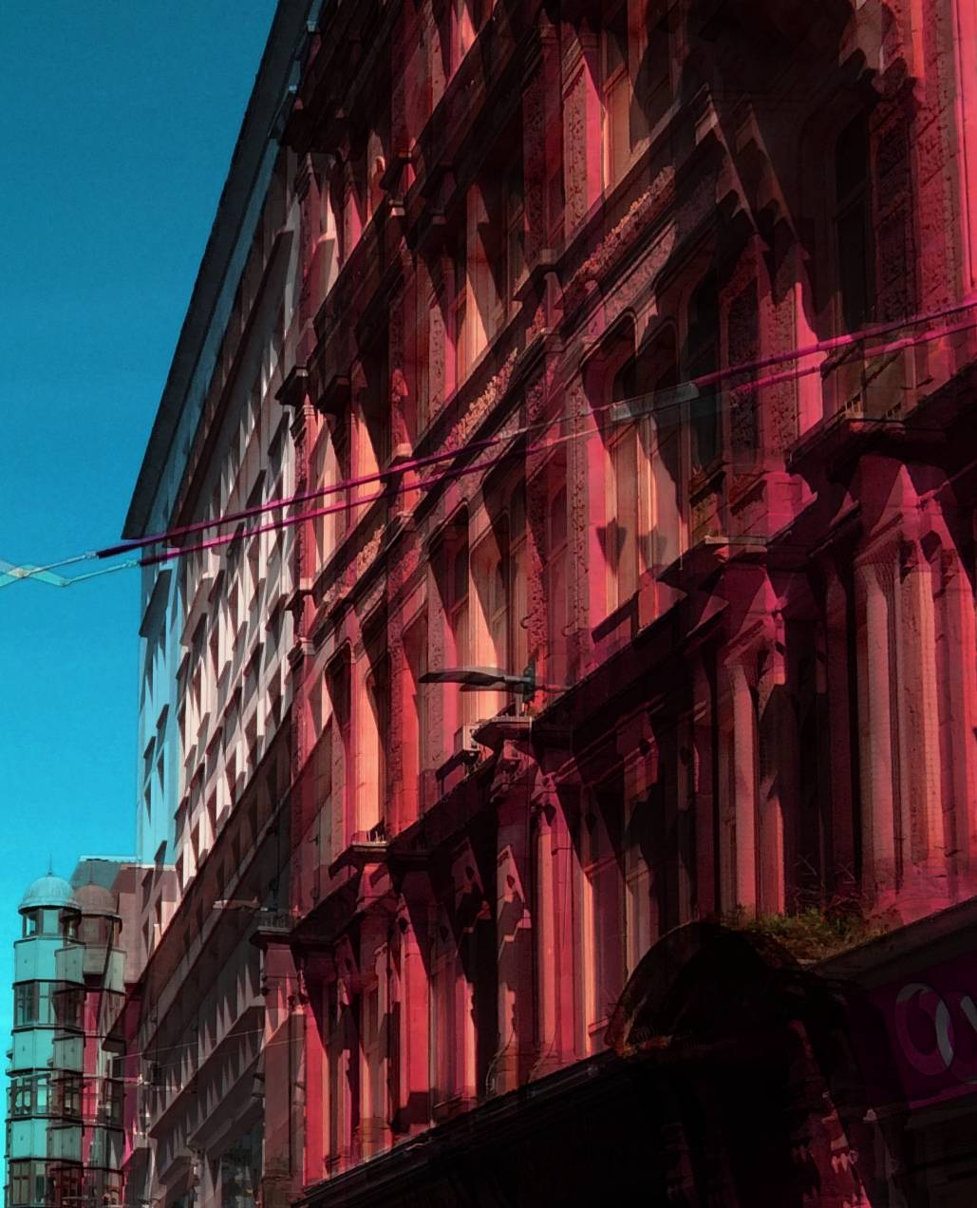
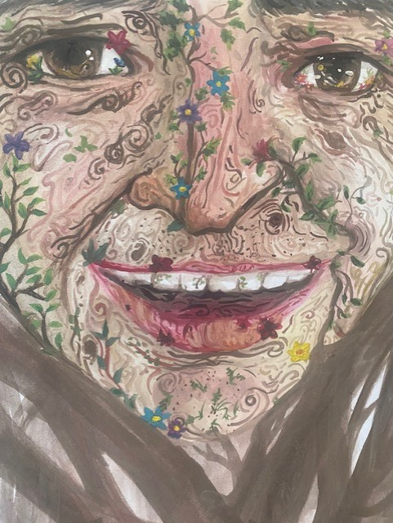
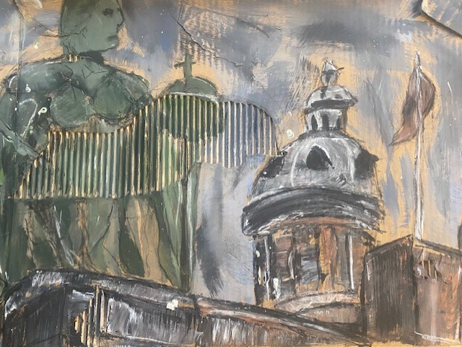
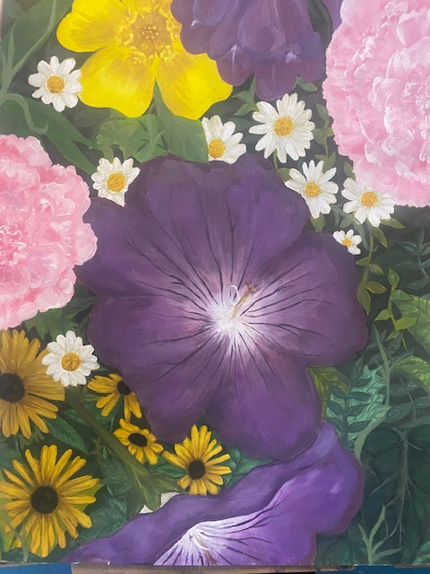
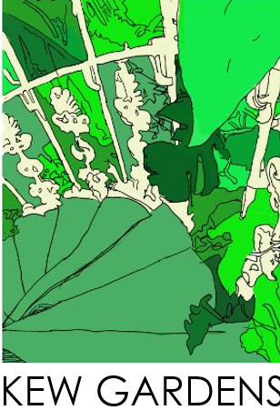
What does the assessment look like
YEAR 10 – COURSEWORK 60%
3 PROJECT UNITS
1 PERSONAL PROJECT WITH CHOICE OF THEMES ‘A ‘A Closer Look, ‘Abundance’, ‘Destruction’
YEAR 11 – EXAM 40%
STUDENTS WILL BE GIVEN A SET THEME BY THE EXAM BOARD.
10 WEEK PREP PERIOD.
10 HOUR EXAM IN ART ROOMS.

Slide 5
What does the assessment look like
YEAR 10 – COURSEWORK 60%
3 PROJECT UNITS
1 PERSONAL PROJECT WITH CHOICE OF THEMES ‘A ‘A Closer Look, ‘Abundance’, ‘Destruction’
YEAR 11 – EXAM 40%
STUDENTS WILL BE GIVEN A SET THEME BY THE EXAM BOARD.
10 WEEK PREP PERIOD.
10 HOUR EXAM IN ART ROOMS.

Slide 6


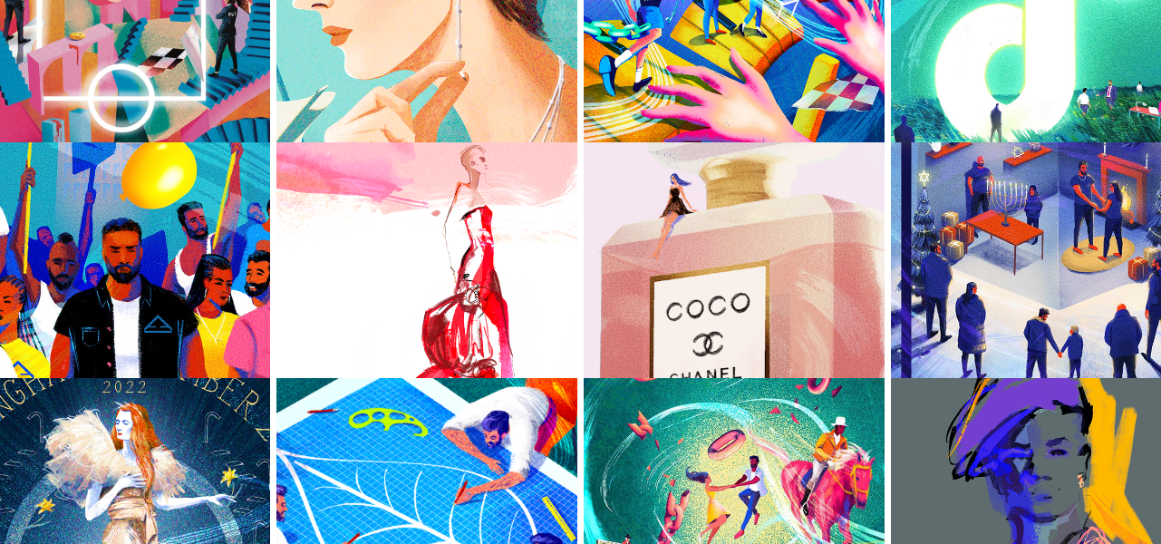
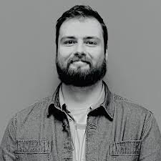
Harry Jones
Harry is an in-house illustrator for Vivienne Westwood in their London studios. He has focus on fashion illustration, editorial, animation and advertisement. He uses multiple techniques with a love for experimentation and the combination of analog, digital, and 3D processes.

Slide 7



