Slide 1
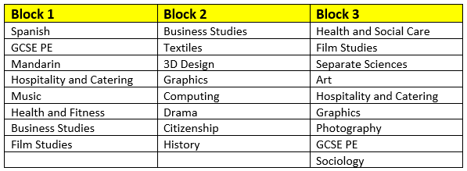

Year 9 Pathways
Welcome to Film Studies

Slide 2
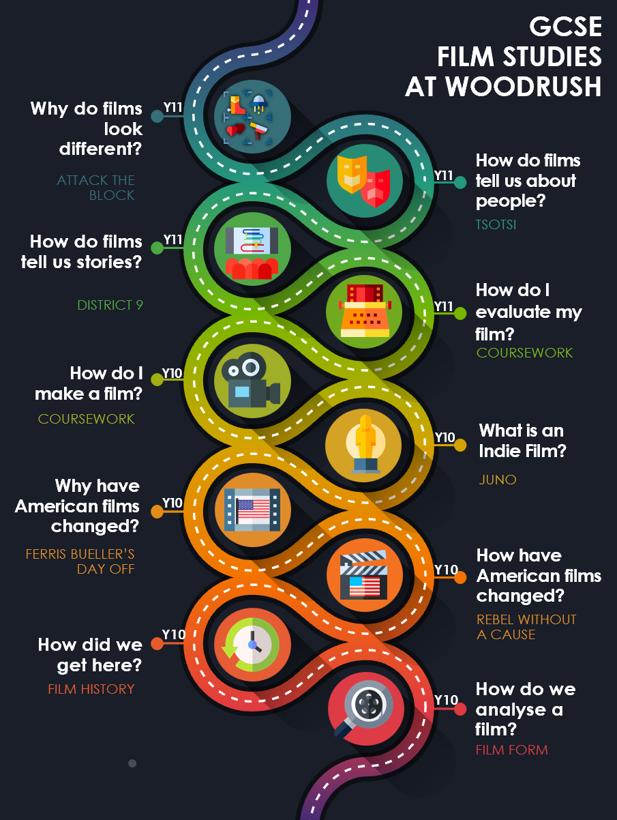



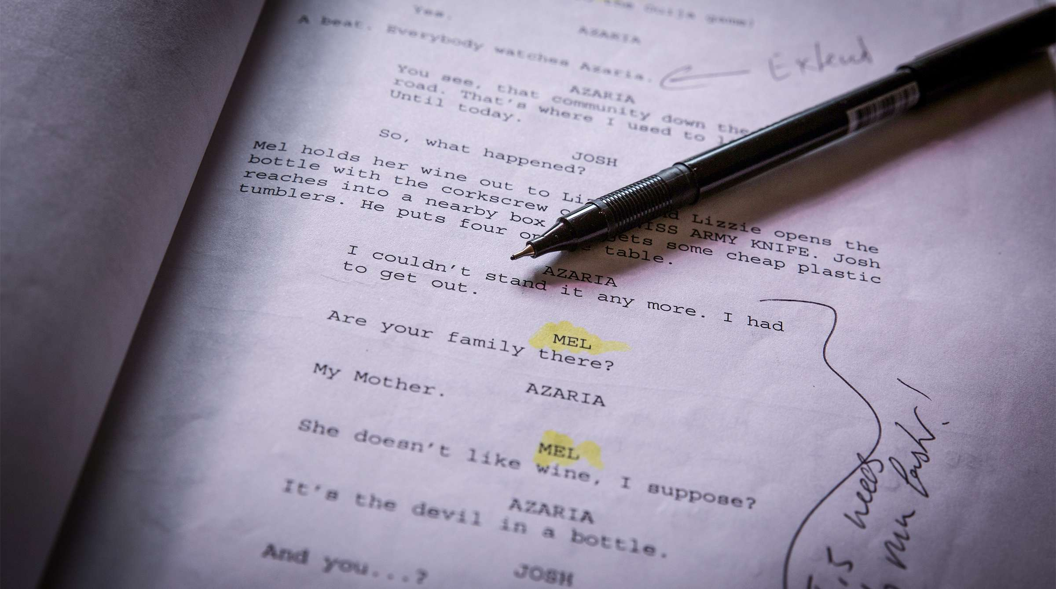

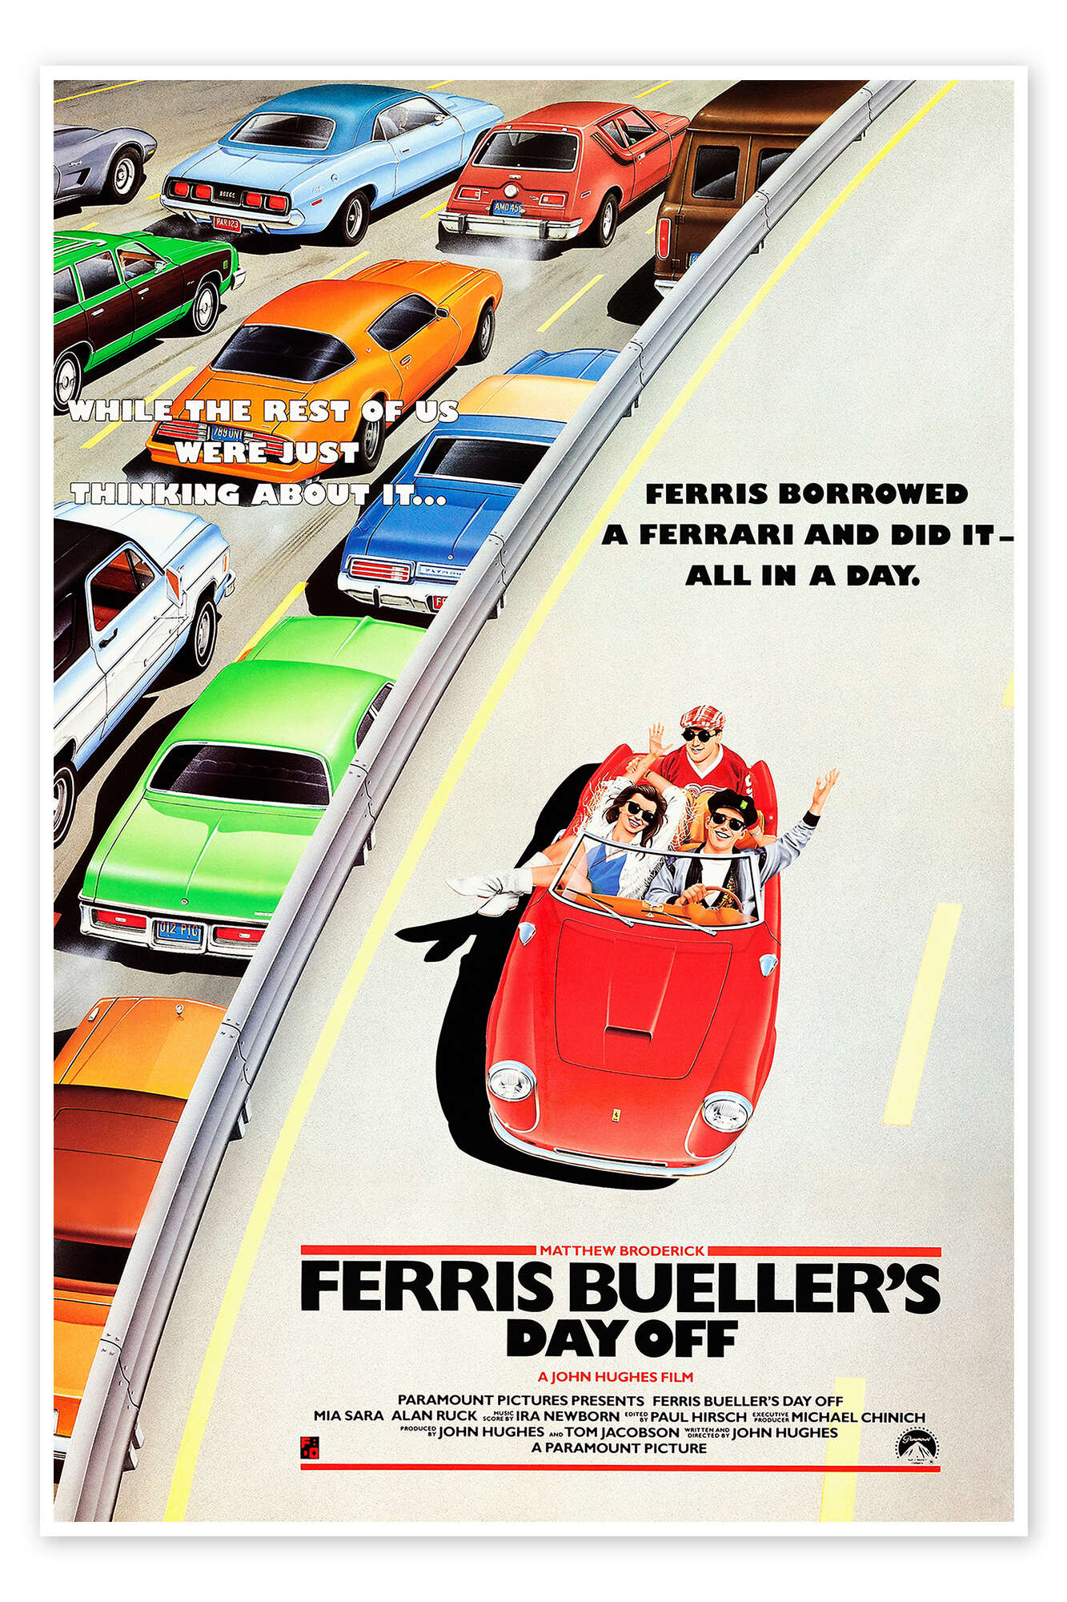

Which topics do we teach?

Slide 3

Film Studies
It is a very popular course – we have two classes each year, and many students opt to carry on at A Level.
Results:
We’ve had grade 9s in every cohort since it began.
The majority of students achieve at least their target.
Comparatively, classes always outperform their other subjects
Consistently among the best results at both GCSE and A Level

Slide 4
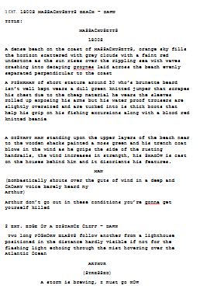
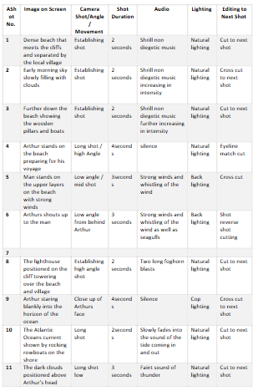
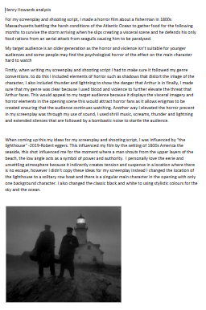
Assessment
How will you get your grade?
35% - Component 1: Key Developments in US Film (1 hour 30, 70 marks)
35% - Component 2: Global Film: Narrative, Representation and Film Style (1 hour 30, 70 marks)
30% - Component 3: NEA (non-examined assessment) (60 marks)
Mocks
Component 1 in Year 11, after Christmas, along with the first draft of the NEA.

Slide 5
What do students think?
“Really enjoyed it so far, and I like the variety of films we’ve looked at”
“I liked being able to be creative for the coursework and had lots of support writing it”
“I like working in booklets as everything is there if I need it”
“I like how it links to some of the other lessons I do”
“We’ve watched films that we wouldn’t normally and enjoyed them”

Slide 6
Where can it lead?
Skills and Knowledge
Analysis
Arguing
Writing
Creative
Research
General Knowledge
Other countries and cultures
Careers
British film industry is one of the most respected in the world, with many Hollywood productions being filmed here.
A variety of careers in practical filmmaking: screenwriting, researching, technician, set designer, costume, etc.
Journalism, Broadcasting, etc.

