Slide 1
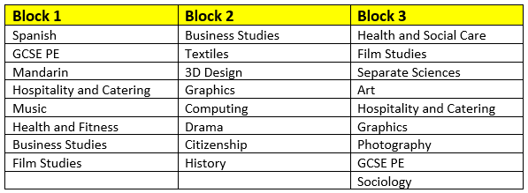
Year 9 Pathways
GCSE Physical Education

Slide 2
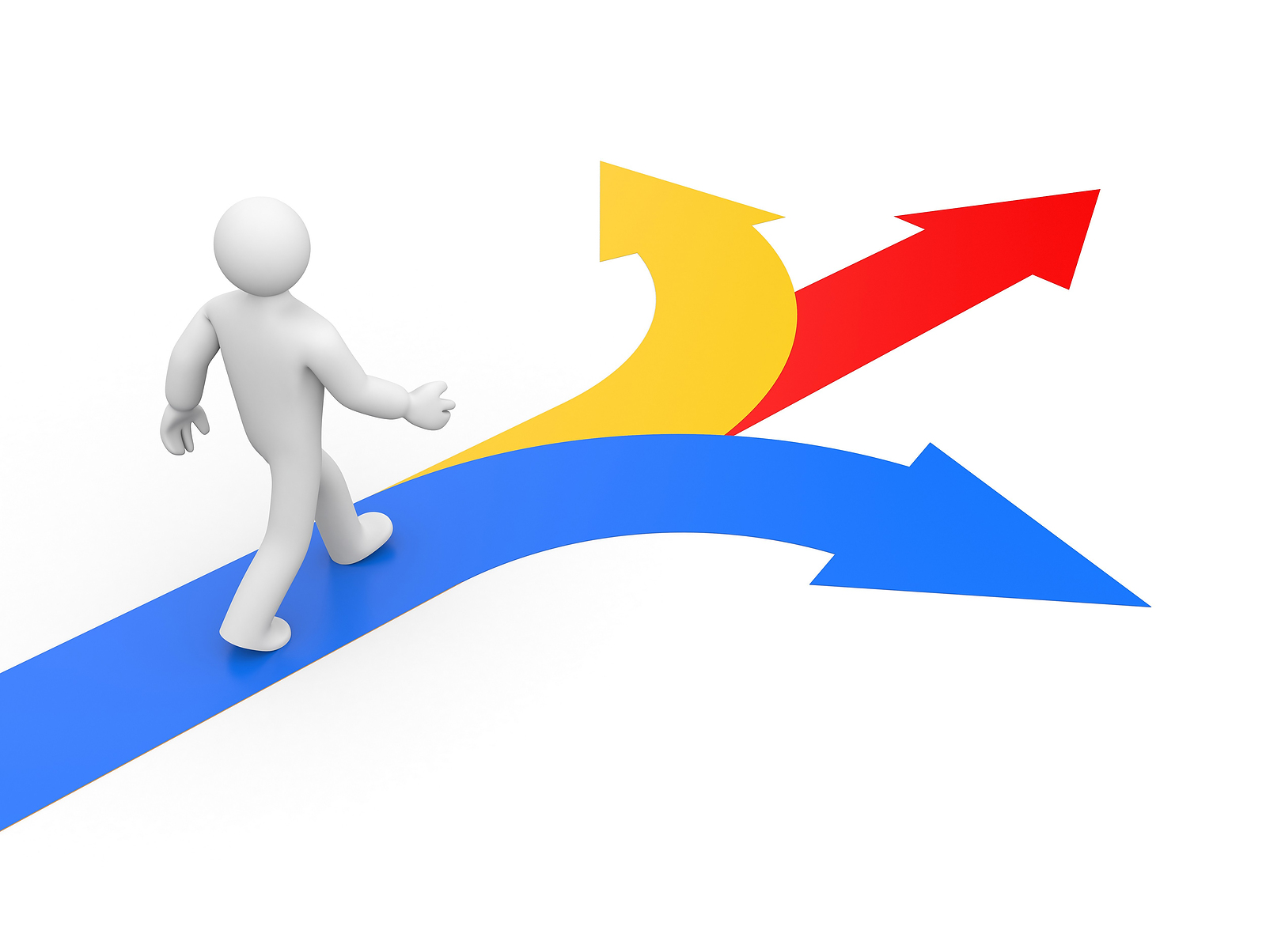
AQA GCSE PHYSICAL EDUCATION (8582)

Slide 3
Which topics do we teach?
Year 10 Paper 1: The human body and movement in physical activity and sport
Applied anatomy and physiology
Movement analysis
Physical training
Use of data
Year 11 Paper 2: Socio-cultural influences and well-being in physical activity and sport
Sports psychology
Socio-cultural influences
Health, fitness and well-being
Use of data
Year 10 and Year 11: Non-exam assessment
Practical performance in physical activity and sport:
Practical performance in three different physical activities
One in a team activity (e.g. football, netball and basketball)
One in an individual activity (e.g. badminton and athletics)
A third in either a team or in an individual activity.
Analysis and evaluation of performance to bring about improvement in one activity.

Slide 4
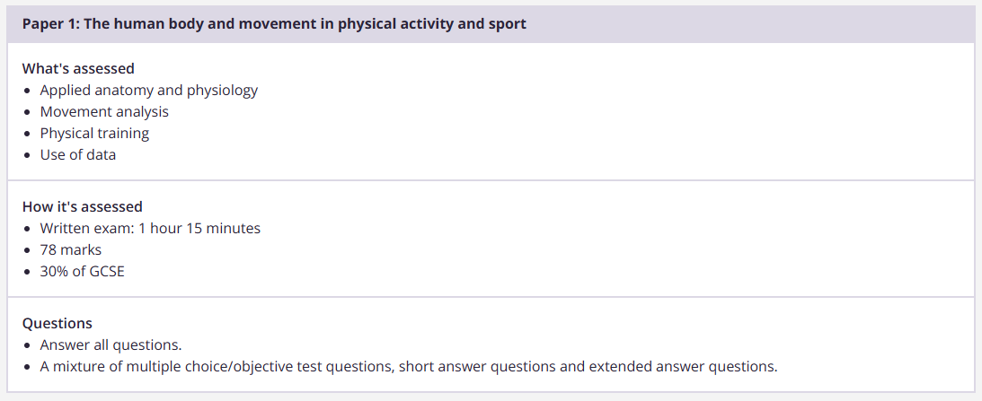
What does the assessment look like?

Slide 5
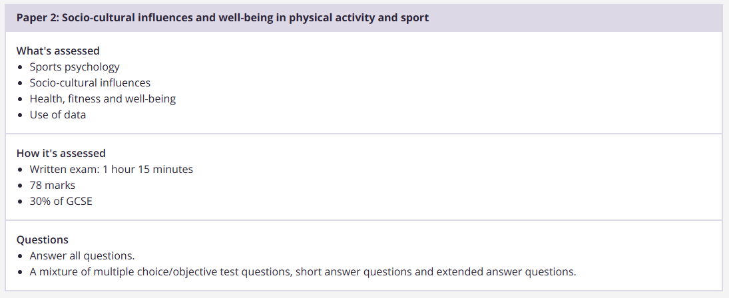
What does the assessment look like?

Slide 6
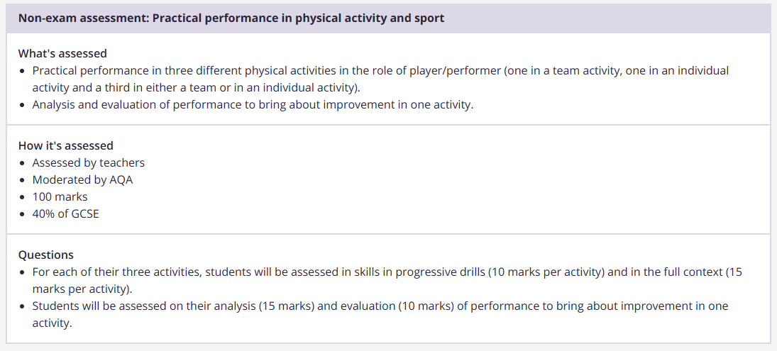
What does the assessment look like?

Slide 7
What does the assessment look like?
GCSE PE student’s will have regular end of topic tests, synoptic assessments and end of year mock exams.

Slide 8
Any other information
GCSE PE is always oversubscribed!
Two classes in Y10 and Y11
GCSE PE is both a Theoretical and Practical subject.
Class sizes are capped at 25
A GCSE in Physical Education can prepare you for many careers such as:
Sports coach, Nutritionist, Personal trainer, Physiotherapist, Sports commentator, PE teacher, Sports scientist, Sport Psychologist, Armed forces, Police and Fire services.
GCSE PE can also prepare you for A Levels & University Degrees.

