Slide 1
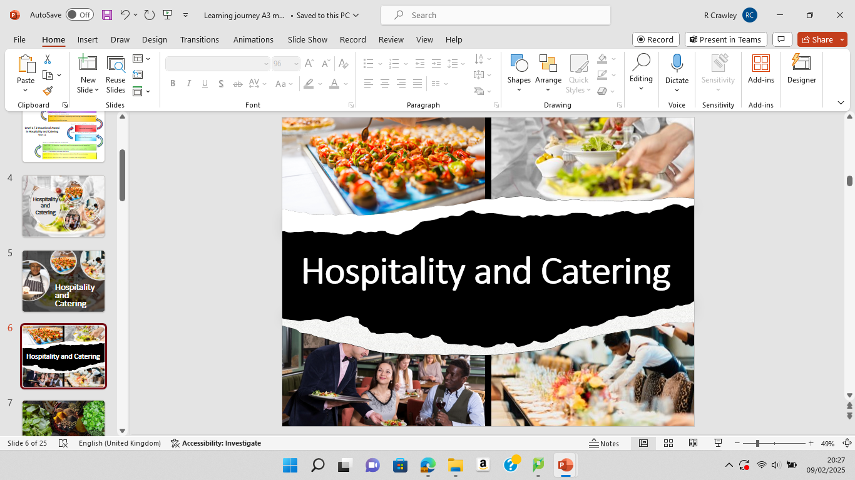

Slide 2
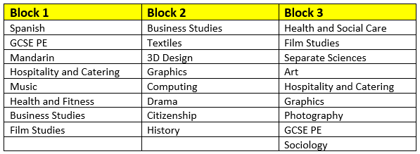
Year 9 Pathways
Hospitality & Catering
Hospitality & Catering

Slide 3
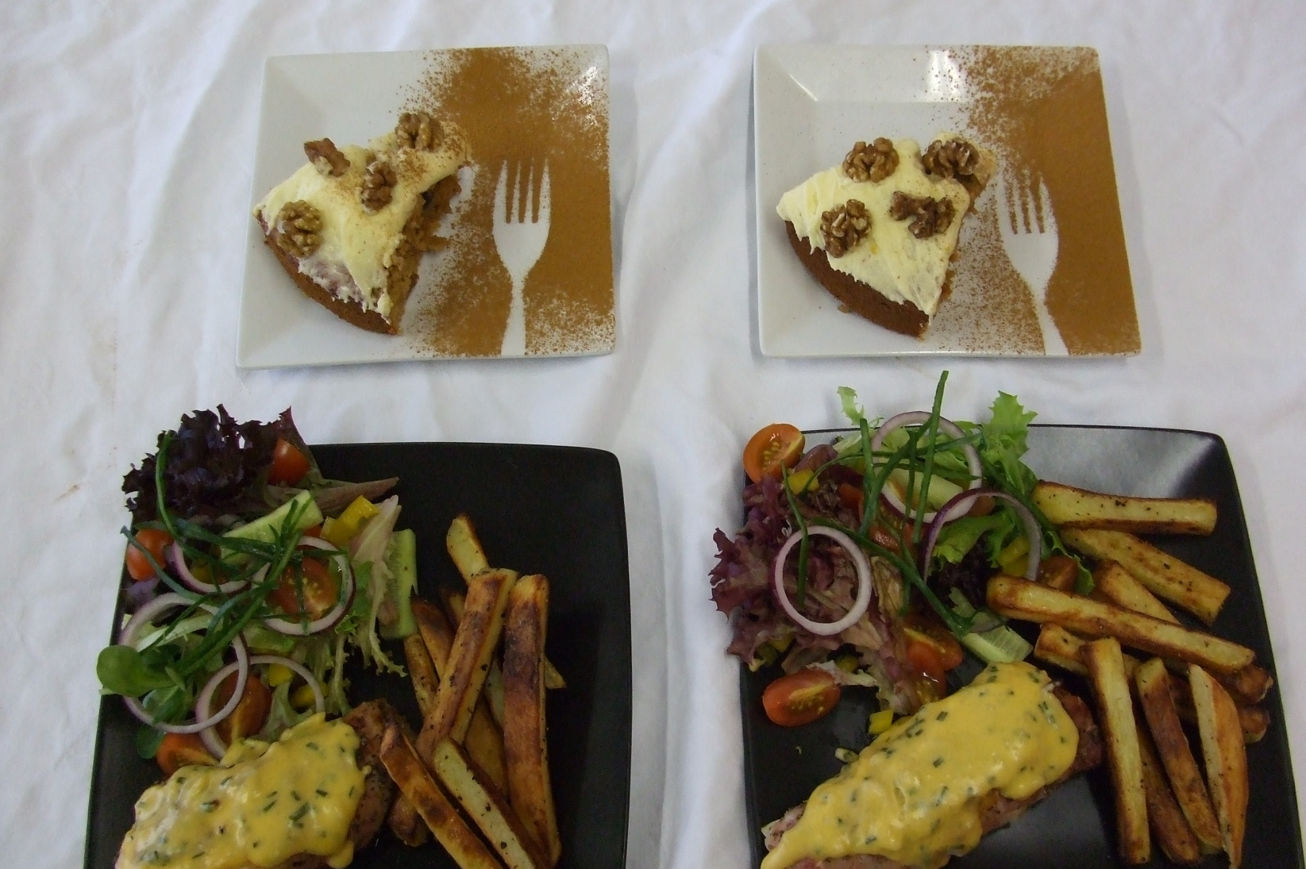

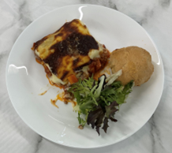
Which Subject do we offer?
WJEC
Level 1/2 Vocational Award Hospitality & Catering
(Technical Award)

Slide 4
Which topics do we teach
Unit 1
1.1 Hospitality and catering provision
1.2 How hospitality and catering providers operate
1.3 Health and safety in hospitality and catering
1.4 Food safety in hospitality and catering
Unit 2
2.1 The importance of nutrition
2.2 Menu planning
2.3 The skills & techniques of preparation, cooking & presentation of dishes
2.4 Evaluating cooking skills

Slide 5
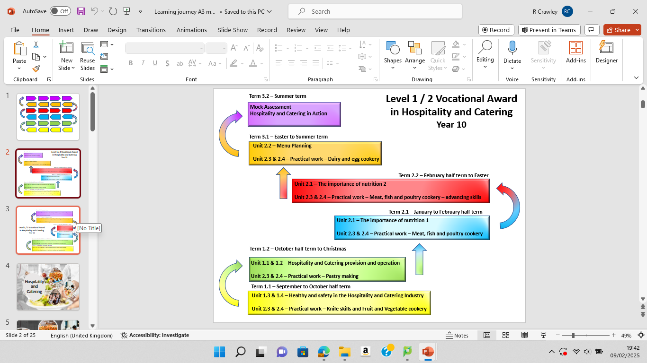
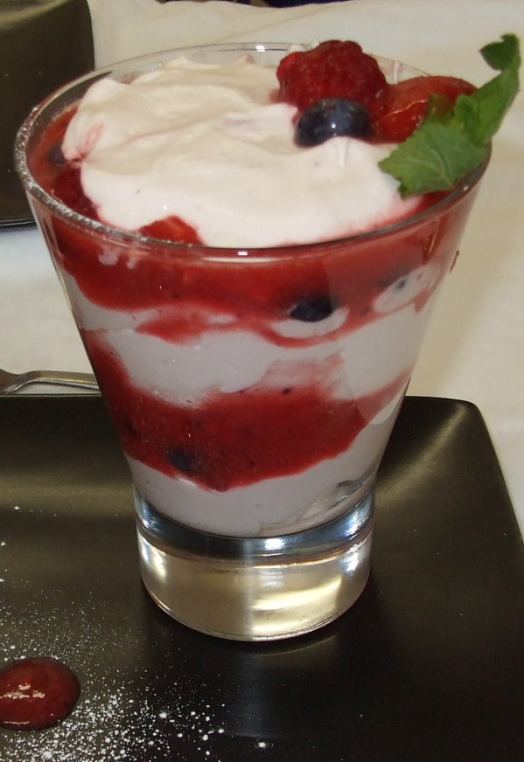

Slide 6
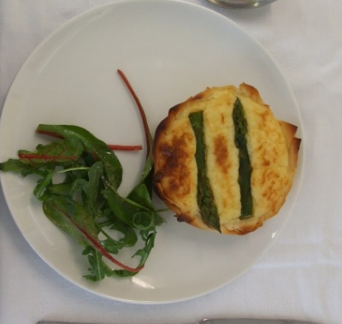
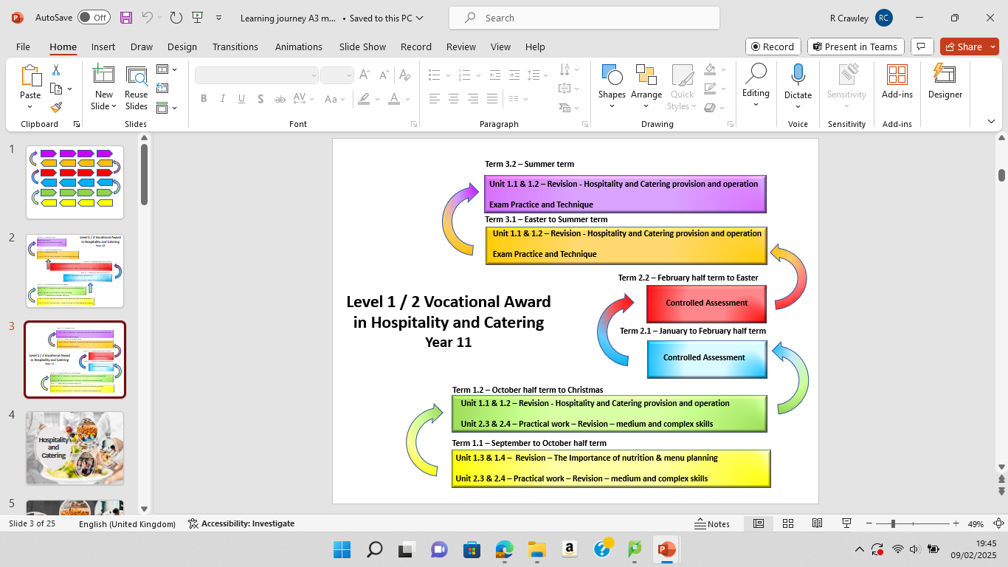

Slide 7
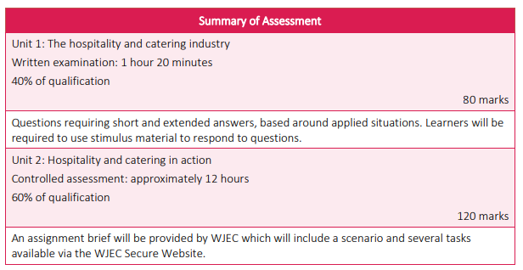
What does the assessment look like

Slide 8

Unit 1 – Written Exam
Sat in the summer exams of year 11
1hr 20min paper
A selection of questions relating to knowledge in unit 1.
Questions vary from multiple choice, mix and match to written responses.
Marked out of 80
Worth 40% of final GCSE grade

Slide 9
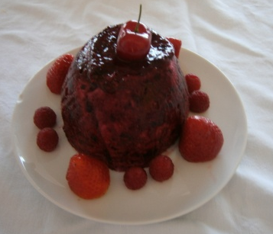
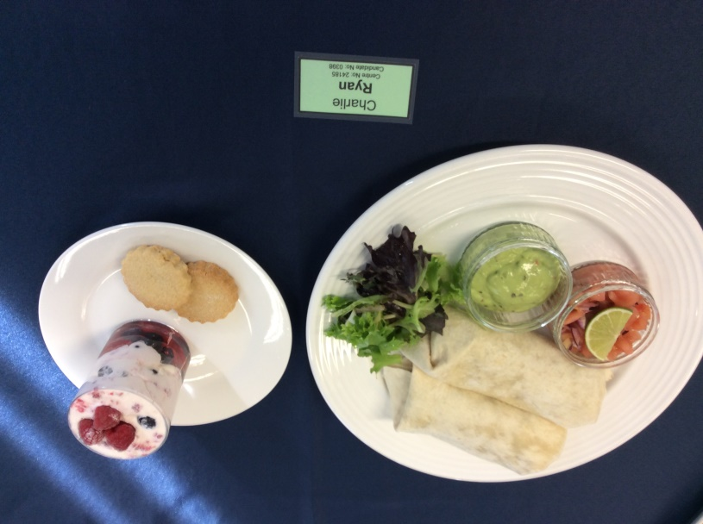
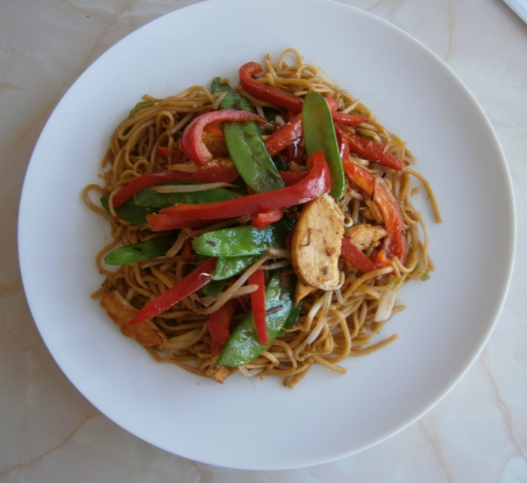
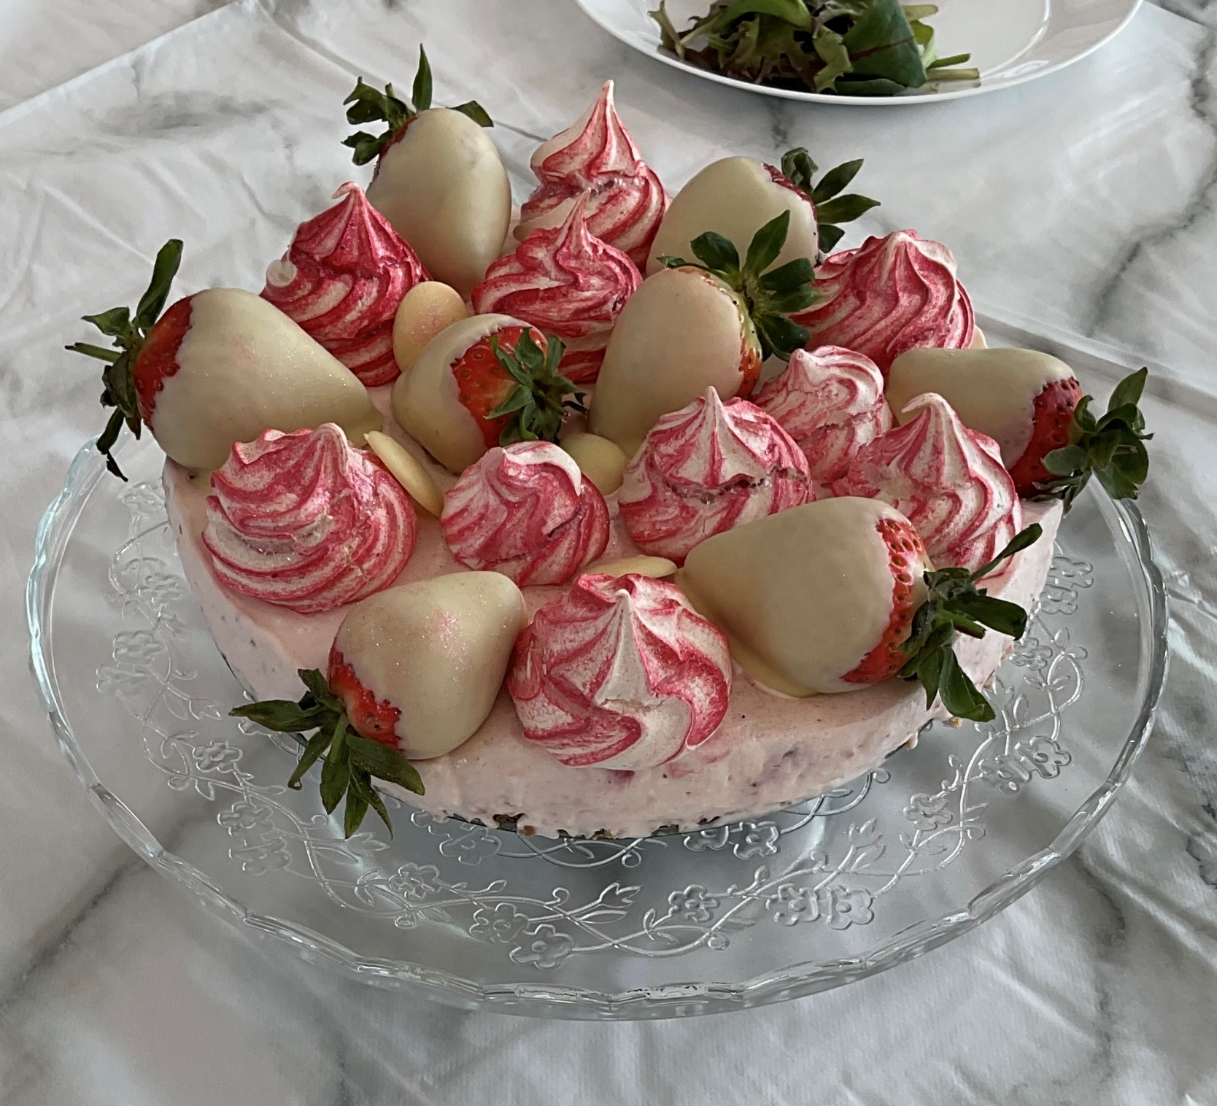
Unit 2 - NEA
Completed in January / February of year 11
Scenario set by exam board and released to teachers in November of year 11
Comprises of four sections
  Analysis of the scenario
  Planning the task
  Practical assessment – 3hour cookery
(2 dishes and accompaniments)
  Evaluation of the assessment
Worth 60% of final GCSE grade

Slide 10
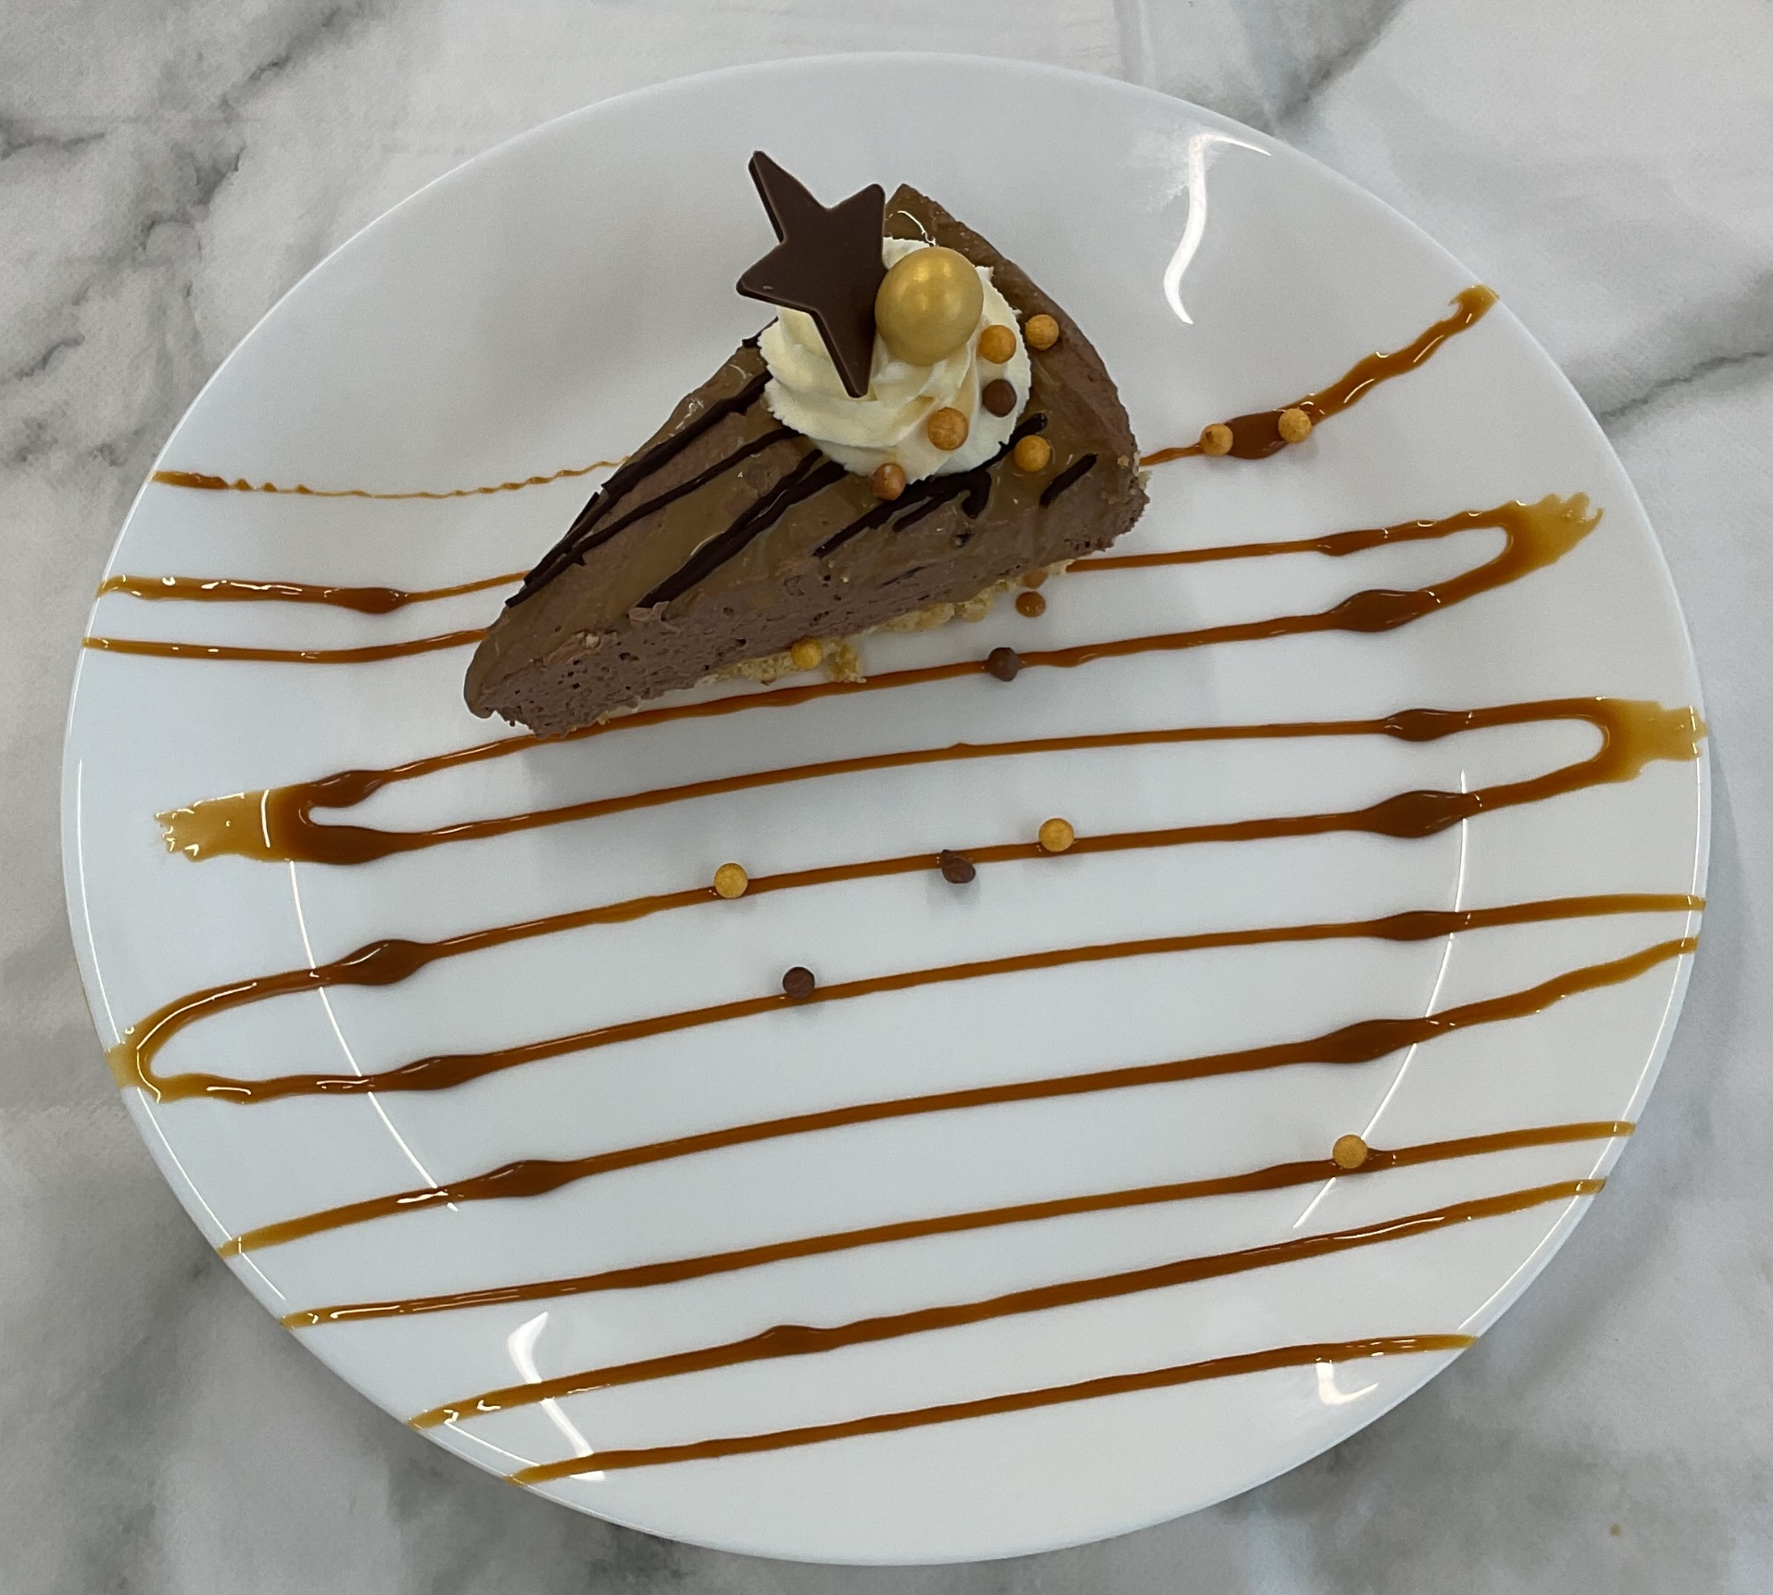
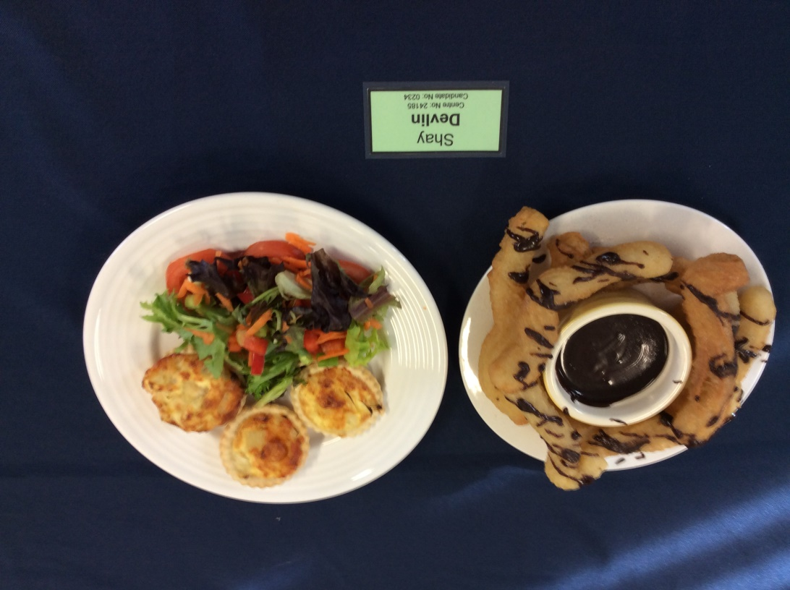
Grading system
GCSE Grade equivalent
Level 2 Distinction plus
Grade 8 / 9
Level 2 Distinction
Grade 6 / 7
Level 2 Merit
Grade 5
Level 2 Pass
Grade 4
Level 1 Distinction
Grade 3
Level 1 Merit
Grade 2
Level 1 Pass
Grade 1

Slide 11
Any other information
Two Classes
20 pupils maximum in each class
One practical lesson per week
Practical lesson can be adapted for individual needs i.e. vegetarian, allergies or religion

Slide 12
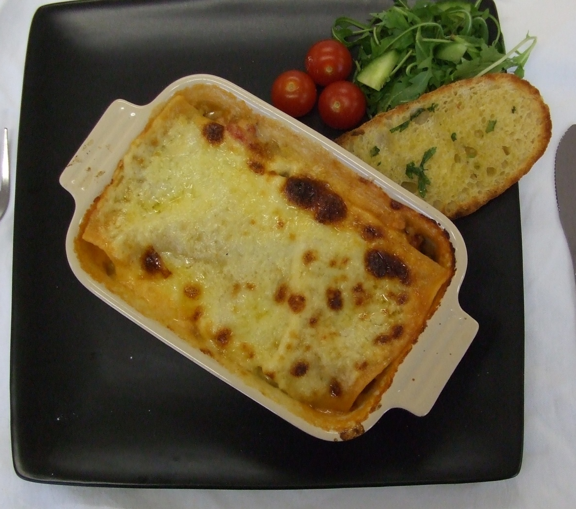
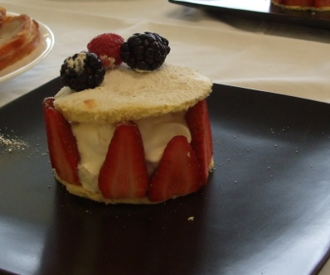
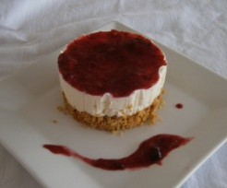
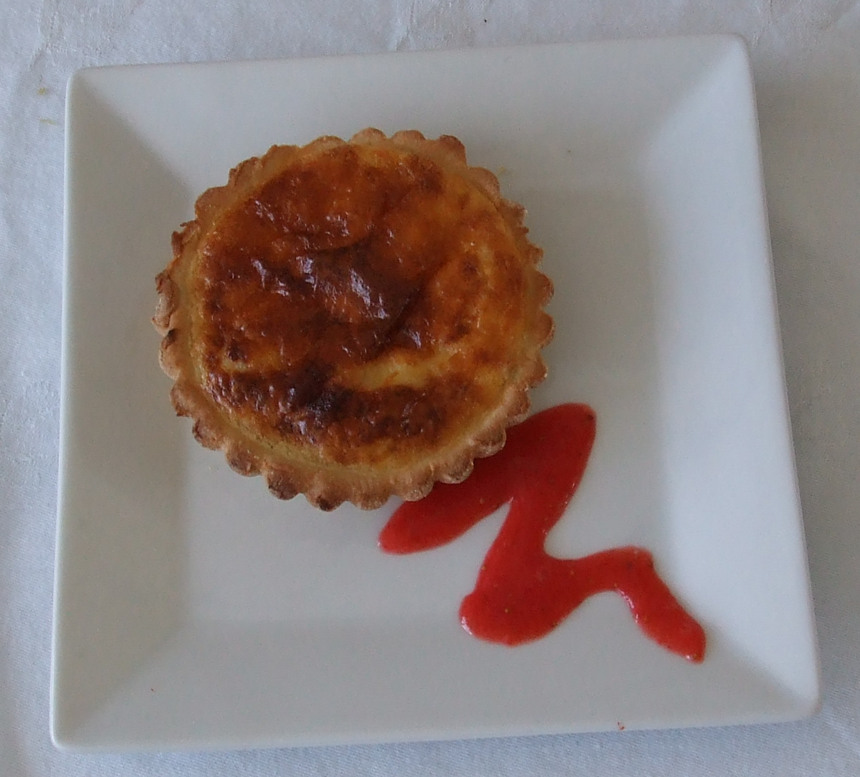
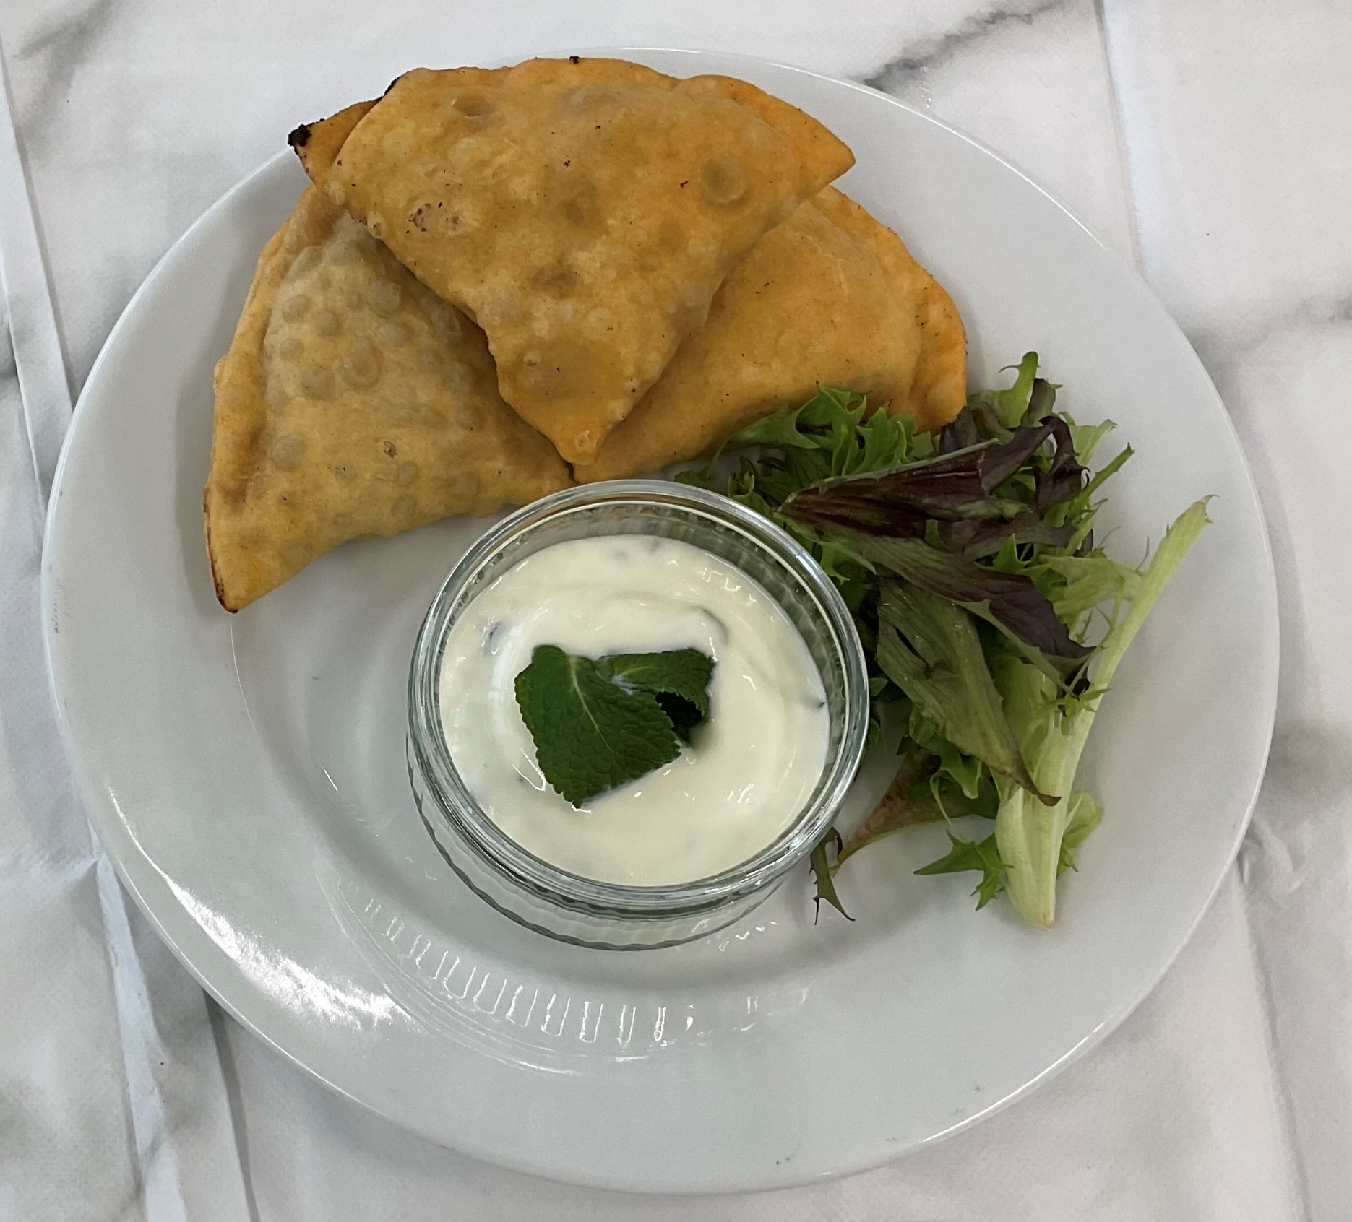
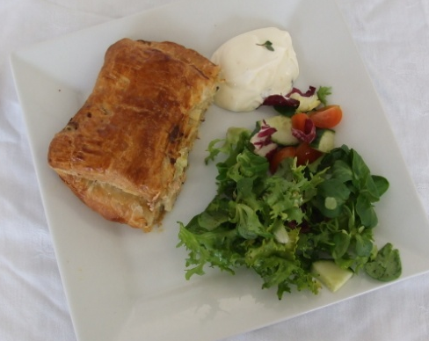

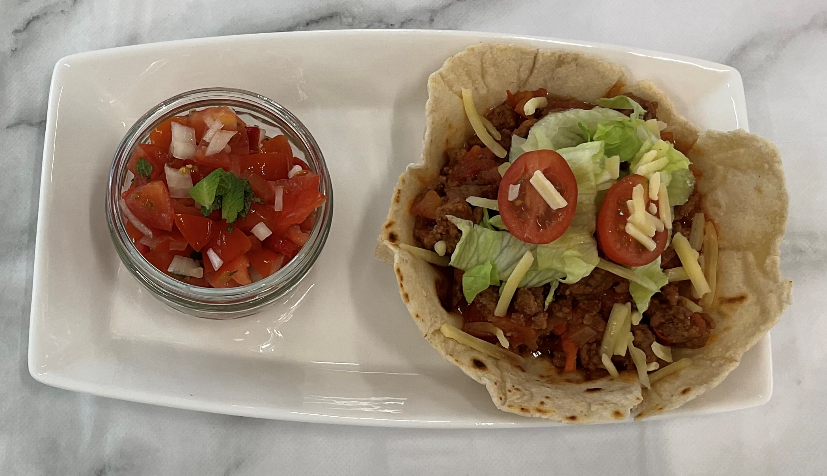
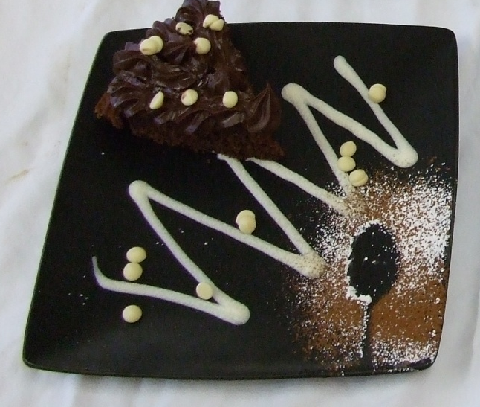
Any
Questions?

