Slide 1
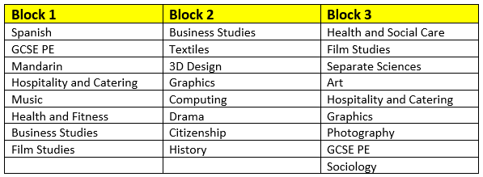
Year 9 Pathways
Welcome to Humanities – History and Geography

Slide 2

Which Subjects do we offer?
GCSE History
Exam board - OCR SHP B
This is a great History course as it offers a wide range of topics to gain the interest of all students.
It also covers a variety of skills such as source analysis and essay style responses.
Student responses require both medium and longer essay based answers.

Slide 3
Which topics do we teach
People’s Health 1250 – Modern day
The development of beliefs and attitudes about disease and health of the people.
Elizabethans
A study about how Elizabeth I made England the richest and most powerful European nation under her rule
Living Under Nazi Rule
From the rise of Hitler to his final downfall at the end of WWII – and the impact on life in Germany and the nations it took over
Making of America
The study of ‘White’ American dominance of the continent and their changing relationship with ‘Natives’ and ‘Black’ Americans
Kenilworth Castle
A study of the changing nature of the site over time

Slide 4
What does the assessment look like?
The 5 topics are assessed across 3 different exam papers:
1 – 1 hour – Kenilworth Castle
2 – 1 hr 45 mins – People’s Health and Elizabethans
3 – 1 hr 45 mins – Living Under Nazi Rule and Making of America
Each of the 5 topics above is worth 20% of the final mark

Slide 5
Additional information
The History department has a long track record of impressive
outcomes for students – with progress being made across all abilities.
High quality teaching staff and resources.
Berlin trip – link to Living Under Nazi Rule topic.
Trip to Kenilworth Castle.
Wide range of interesting topics.
Multi skills – evidence gathering, debating, constructing an argument, comparing, analysing, inferring - all link to a range of careers.

Slide 6
Which Subjects do we offer?
GCSE Geography.
Exam board - AQA
This is a broad and balanced course that includes Physical Geography, Human Geography and fieldwork.
It also covers a variety of skills such as cartographical, numeracy, literacy and enquiry based problem solving.
Student responses require factual knowledge, statistical analysis and short and medium length extended prose answers.

Slide 7
Which topics do we teach
Physical
The challenge of natural hazards
Plate tectonics, earthquakes, volcanoes, tropical storms and climate change.
UK physical landscapes
Coastal and fluvial processes
Coastal and fluvial landforms
Coastal and fluvial management
The living world
Local ecosystems, rainforest characteristics, deforestation causes and management. Desert characteristics, opportunities and challenges.
Human
Urban issues and challenges
Megacities, Urbanisation, opportunities and challenges in a low income city (Rio de Janeiro, opportunities and challenges in a high income city (Birmingham).
The changing economic world
The development gap- Causes and solutions, Case study of a newly emerging economy (Nigeria). The UK economy.
Resource management
Food, water and energy provision and management in the UK and energy provision and management abroad.

Slide 8
What does the assessment look like?
The six topics are examined in two separate 1 hour 30 GCSE examinations
There is an additional applied skills based paper that includes pre release material and questions based on fieldwork conducted at the end of Year 10.
1 hr 30- Living with the physical environment.
1 hr 30- Challenges in the human environment.
1 hr 30- Geographical applications.

Slide 9
Additional information
The Geography department has a long track record of impressive outcomes for students – with progress being made across all abilities.
All teachers are vastly experienced and due to GCSE popularity,
our A level cohort has increased rapidly in size in recent years.
Multi skills – Creating and analysing a range of graphs and cartographical images. Statistical and photographical analysis, enquiry based field studies, debating, evaluating and extended writing.
Trips include
Carding Mill Valley
Solihull town centre
Iceland (early 2027 planned)

