Slide 1
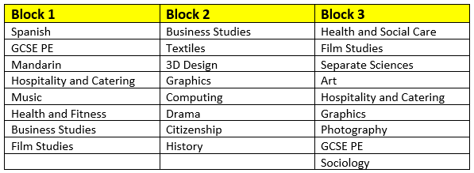
Year 9 Pathways
NCFE HEALTH & FITNESS

Slide 2

NCFE LEVEL 1 /2 TECHNICAL AWARD IN HEALTH & FITNESS QN: 603/7007/5
The equivalent of a Level 2 Gym instructor course
The course is heavily theory with occasional lessons taking place in
The gym.
NB. We do not study a variety of sports, the focus is in the gym
and preparing students to be able to carry out gym inductions and
Which will then allow then further study Level 3 Personal
Training post 16.

Slide 3
Which topics do we teach?
Year 10 and 11 Exam work – You must study each of the 8 different content areas as part of the qualification
Content area 1: Structure and function of body systems
Content area 2: Effects of health and fitness activities on the body
Content area 3: Health and fitness and the components of fitness
Content area 4: Principles of training
Content area 5: Testing and developing components of fitness
Content area 6: Impact of lifestyle on health and fitness
Content area 7: Applying health and fitness analysis and goal setting
Content area 8: Structure of a health and fitness programme and how to prepare safely
Year 11: Non-exam assessment coursework worth 60%
Year 11 : Written exam 40% of the overall grade

Slide 4
How will I be assessed?
You will complete two assessments
Non-exam assessment (NEA): External project set by the exam board. You are required to draw together and apply knowledge learned throughout the course. You will be given a brief set by NCFE based on a real life situation and will have 22 hours to complete it.
Written Exam: This will last one hour and 30 minutes and will include some multiple choice, short answers and extended response
questions. The exam is out of 80 marks and worth 40%. The
written exam will be completed at the end of the course.

Slide 5
What does the assessment look like?
Health and fitness student’s will have regular end of topic tests, synoptic assessments and end of year mock exams.

Slide 6
Any other information
The following grades are available for this qualification
Level 1 Pass, Merit and Distinction
Level 2 Pass, Merit, Distinction and Distinction*
Health and fitness can prepare you for many careers such as: Gym instructor
Sports coach, Nutritionist, Personal trainer,
If you are still unsure about this course go and see any of the
following staff; Mrs Bridgen, Mr Taylor and Miss Dunn.

