Slide 1




Apprenticeship Support and Knowledge for Schools

Slide 2

What are apprenticeships?

Slide 3
Some of the possibilities

Slide 4
LEVELS OF APPRENTICESHIP
TRAINEESHIPS
INTERMEDIATE APPRENTICESHIP
LEVEL 2
12 – 18 MONTHS
ADVANCED APPRENTICESHIP
LEVEL 3
12 – 36 MONTHS
HIGHER/DEGREE APPRENTICESHIP
LEVELS 4, 5, 6 & 7
12 – 48 MONTHS
SKILLS, KNOWLEDGE AND COMPETENCIES

Slide 5


You get paid and you have a career
National Minimum Wage £3.40 per hour
Average wage £170 per week
Wage depends on the employer – many pay more than Minimum Wage

Slide 6
Are there any jobs?
Over 28,000 apprenticeship vacancies advertised each year
5 miles = 92 apprenticeships
10 miles = 313 apprenticeships
15 miles = 603 apprenticeships
20 miles = 896 apprenticeships

Slide 7

There’s never been a better time…
The world of work and career opportunities just got a whole lot more exciting …really!

Slide 8
Higher and Degree apprenticeships
Now its possible to get a degree without going to uni…

Slide 9

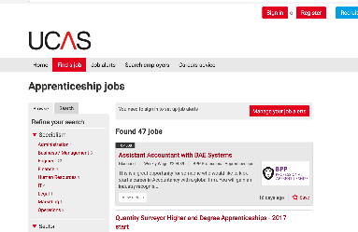
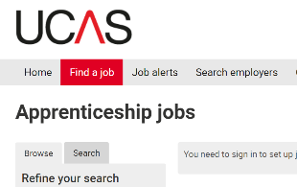
University – have a plan A and B
https://careerfinder.ucas.com/jobs

Slide 10
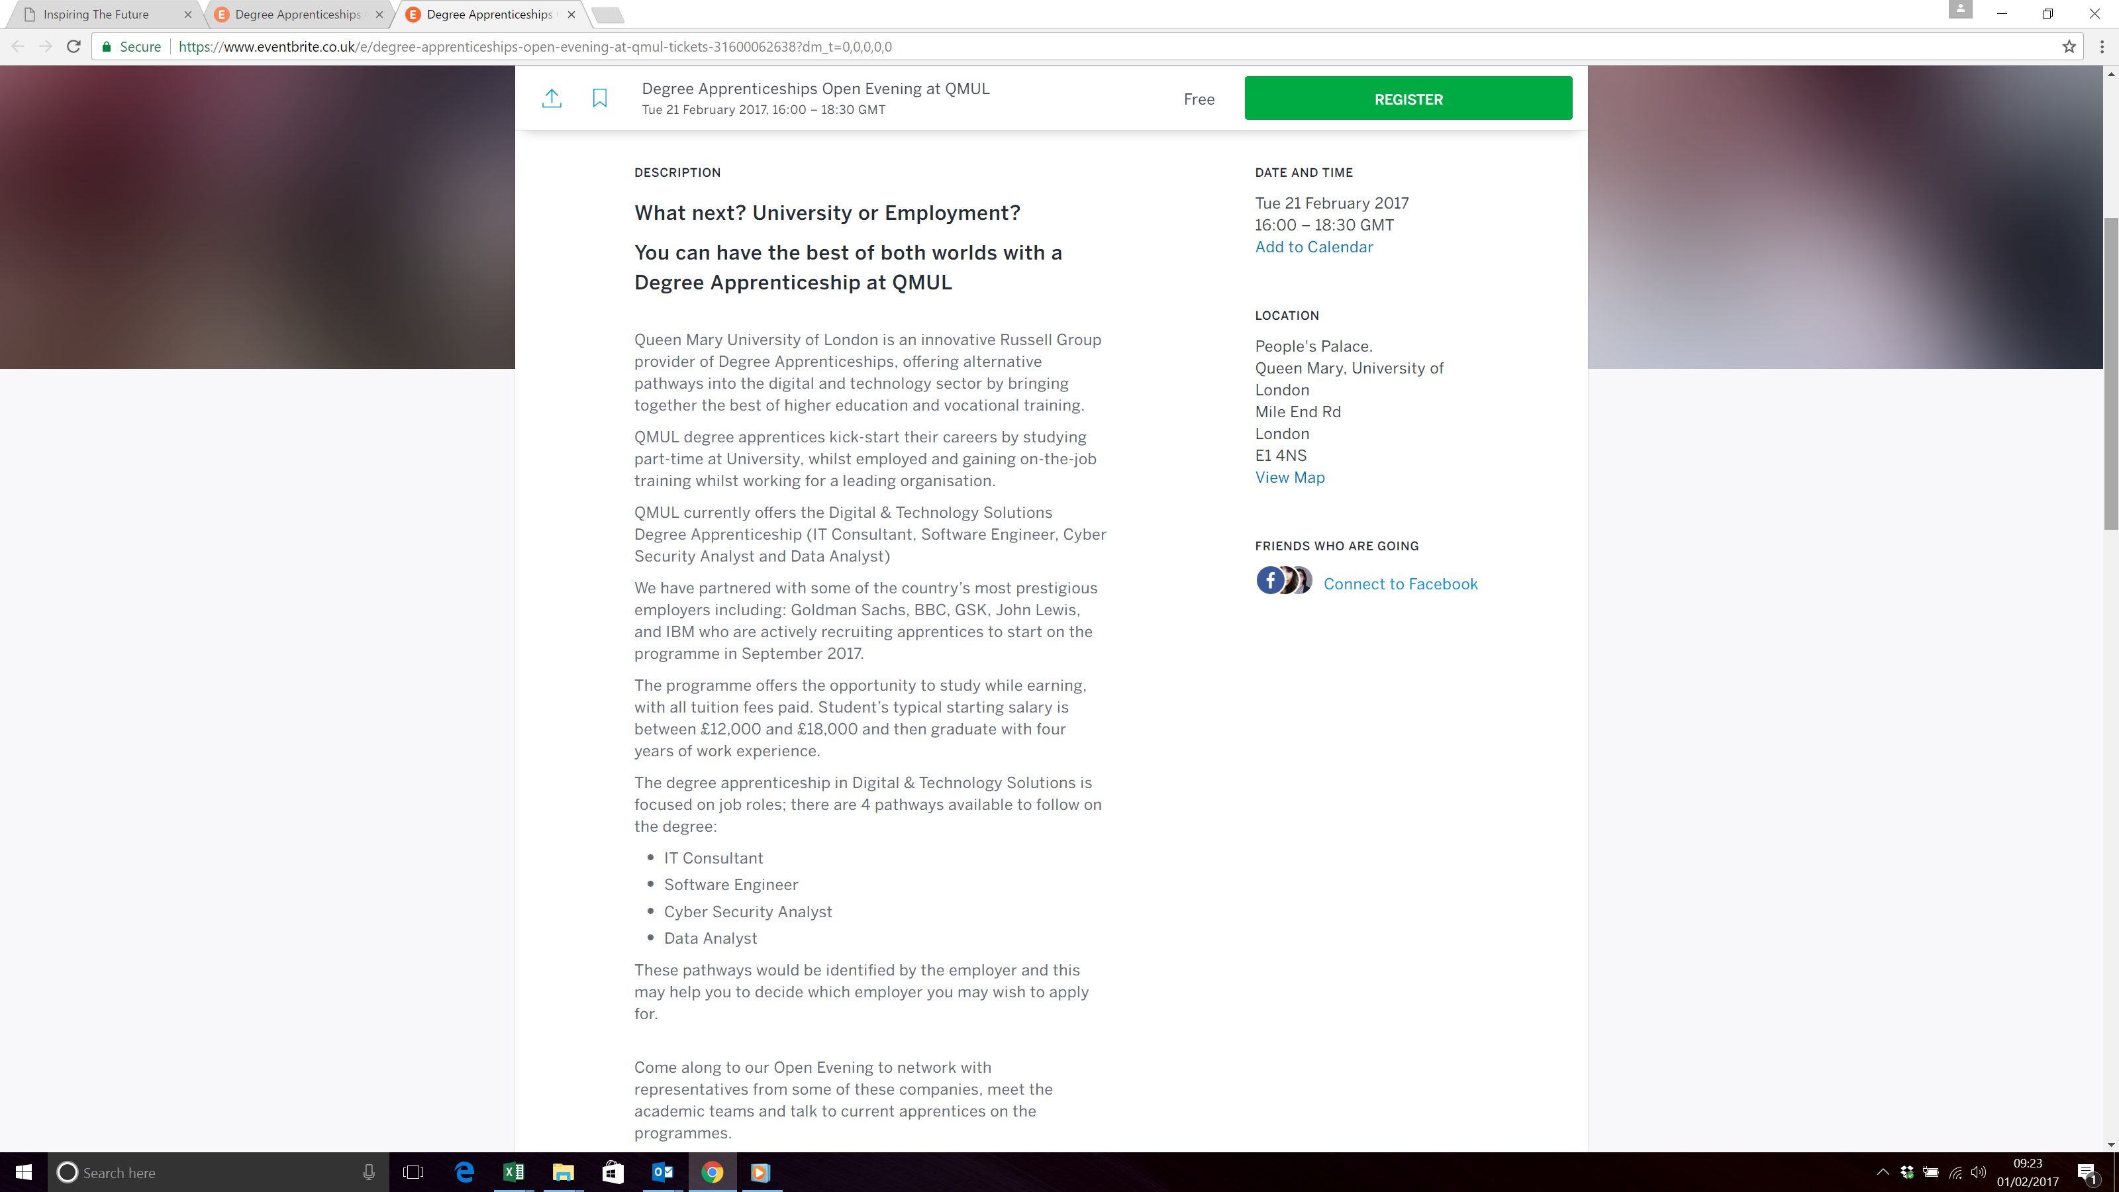
Example: Degree Apprenticeship Event – Queen Mary’s London

Slide 11
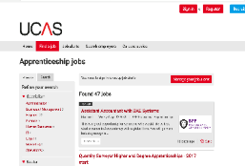
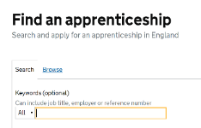
How do you find an apprenticeship?
Register on Find an apprenticeship or with https://www.gov.uk/apply-apprenticeship
(Ideally create an account & respond to your email to activate it)
Do your research and search for jobs
Start applying
Manage your alerts
Make contact with the companies

Slide 12
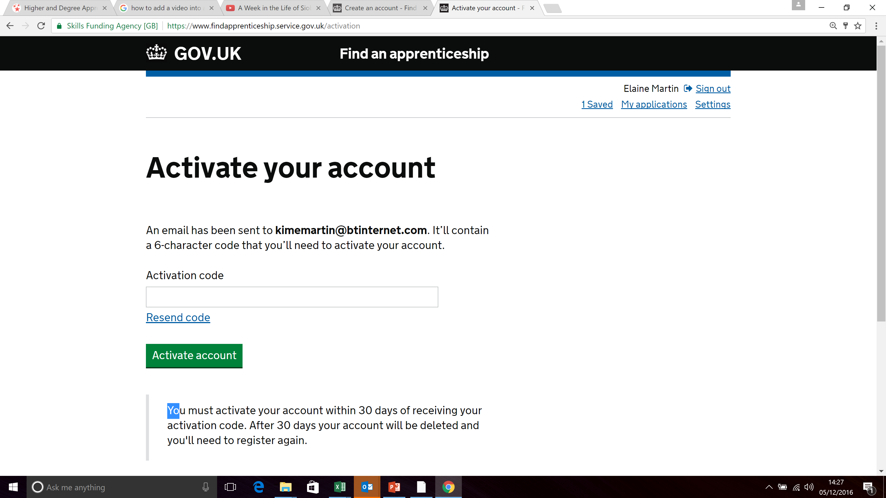
NAME
Email address

Slide 13
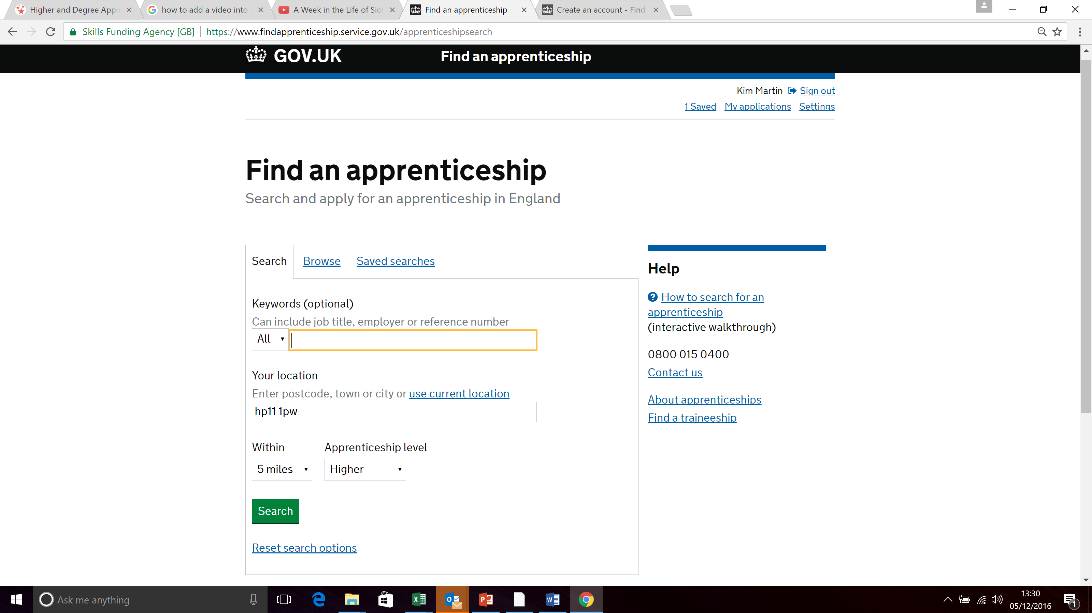
Enter any keywords, your home postcode, how far you can travel and level of apprenticeship

Slide 14
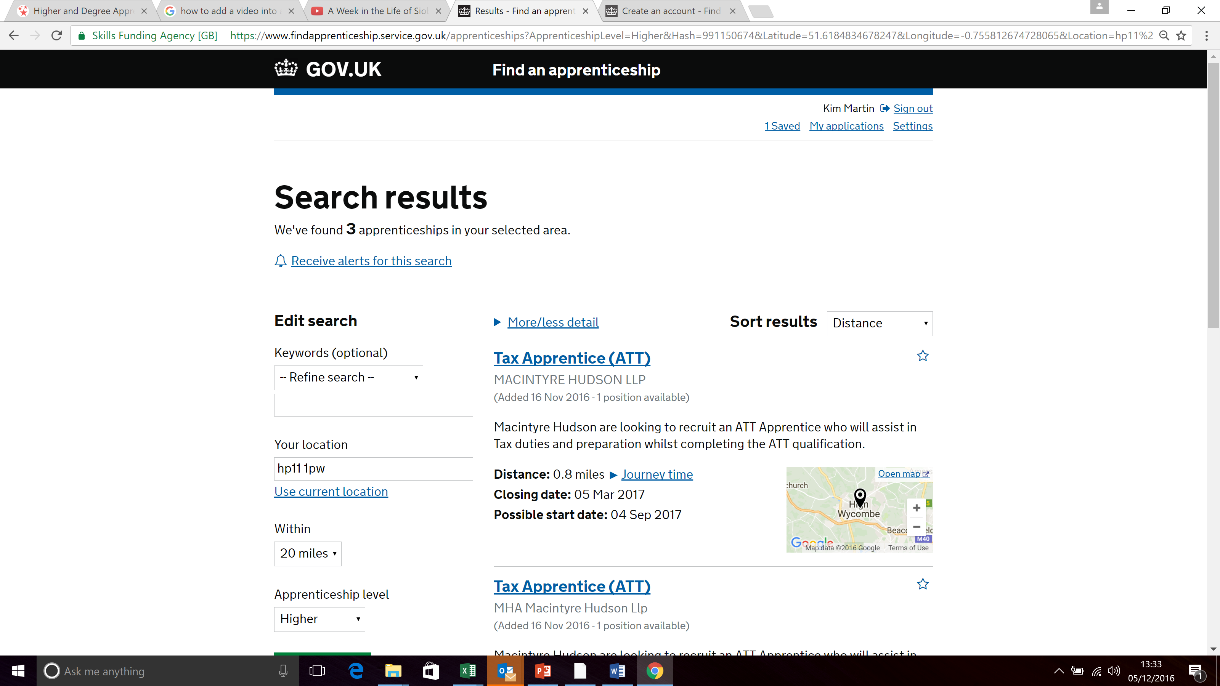
Click ‘Receive alerts for this search’ to have new vacancies sent to your mobile phone and /or email.
Click on the Job title to see further details of the role and the training.

Slide 15
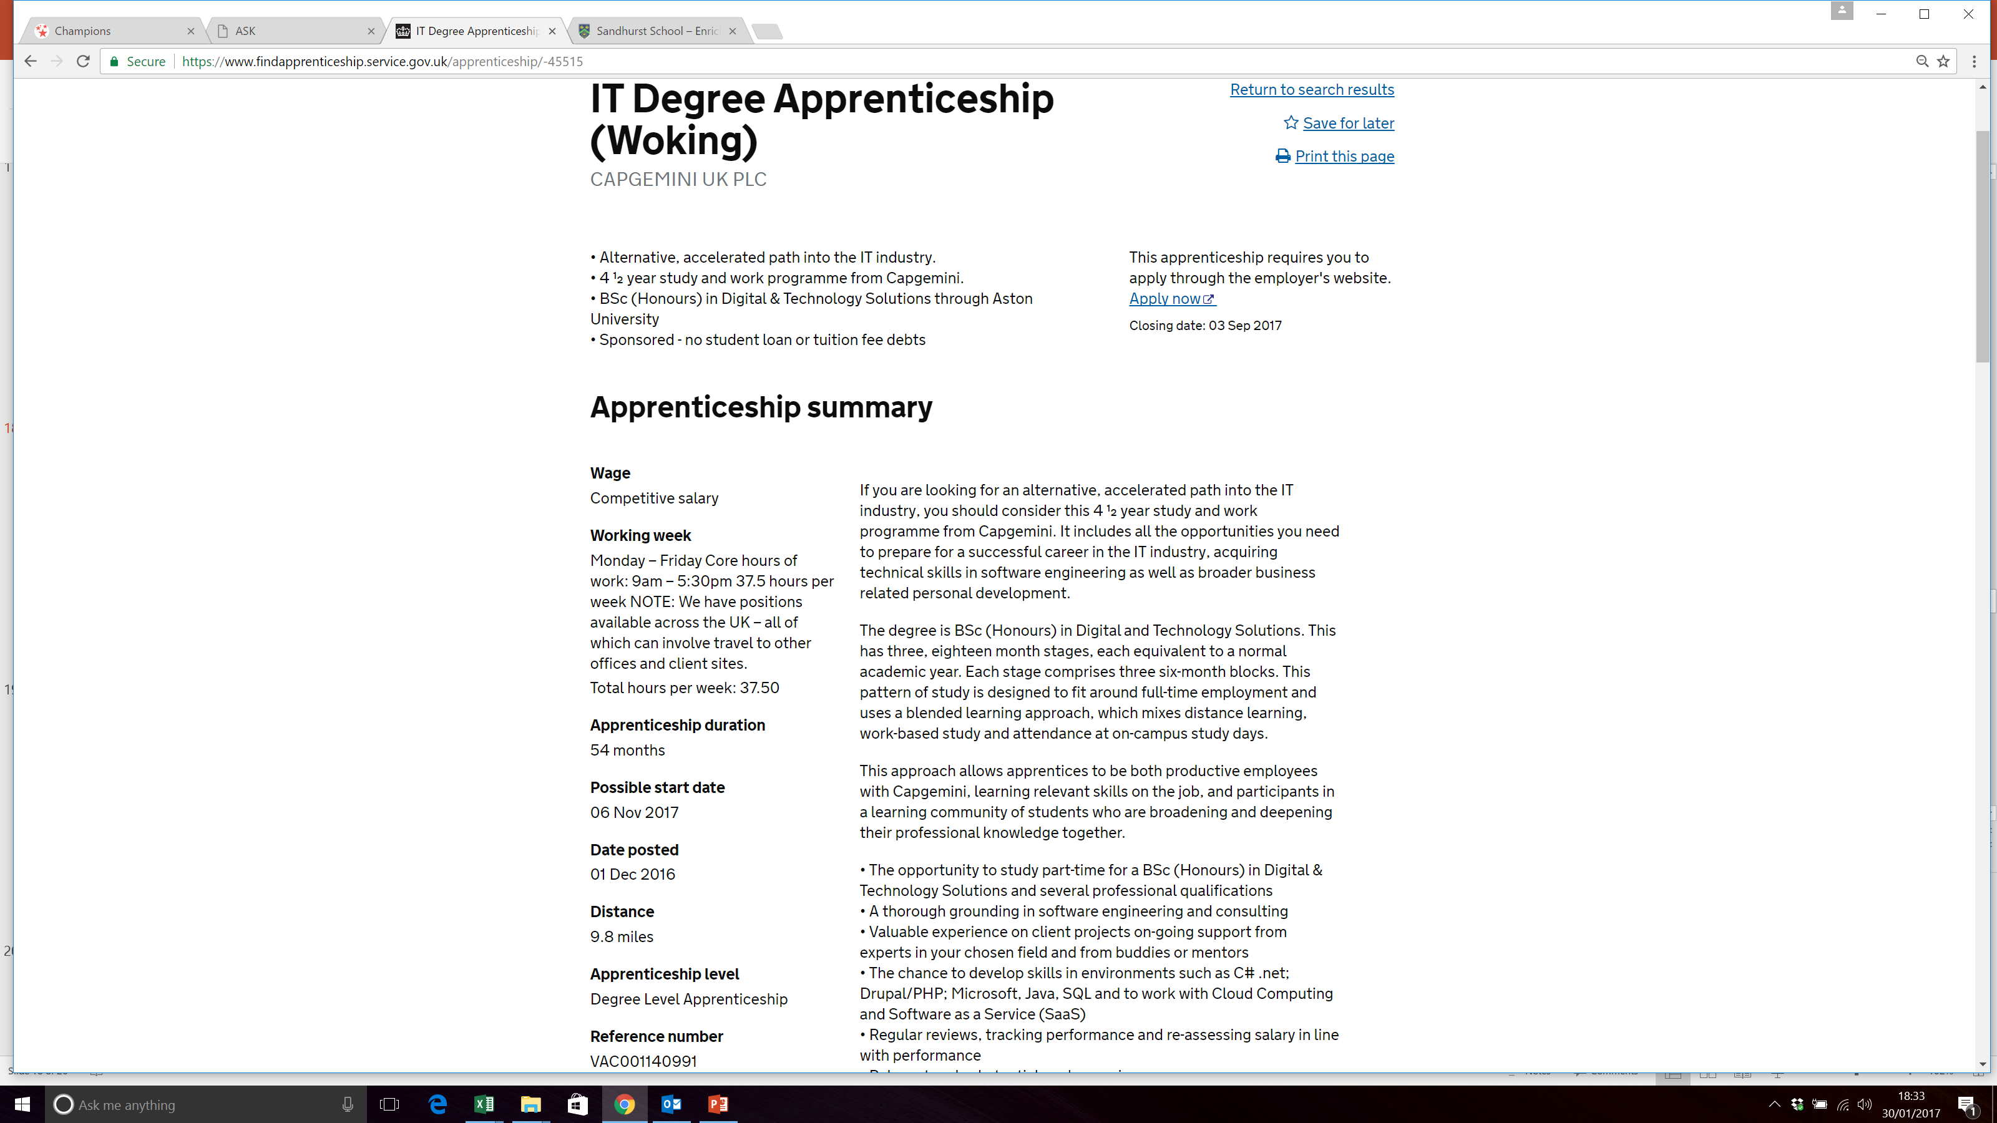
Look at the details.
You can Save the job to refer to later or Print the page

Slide 16
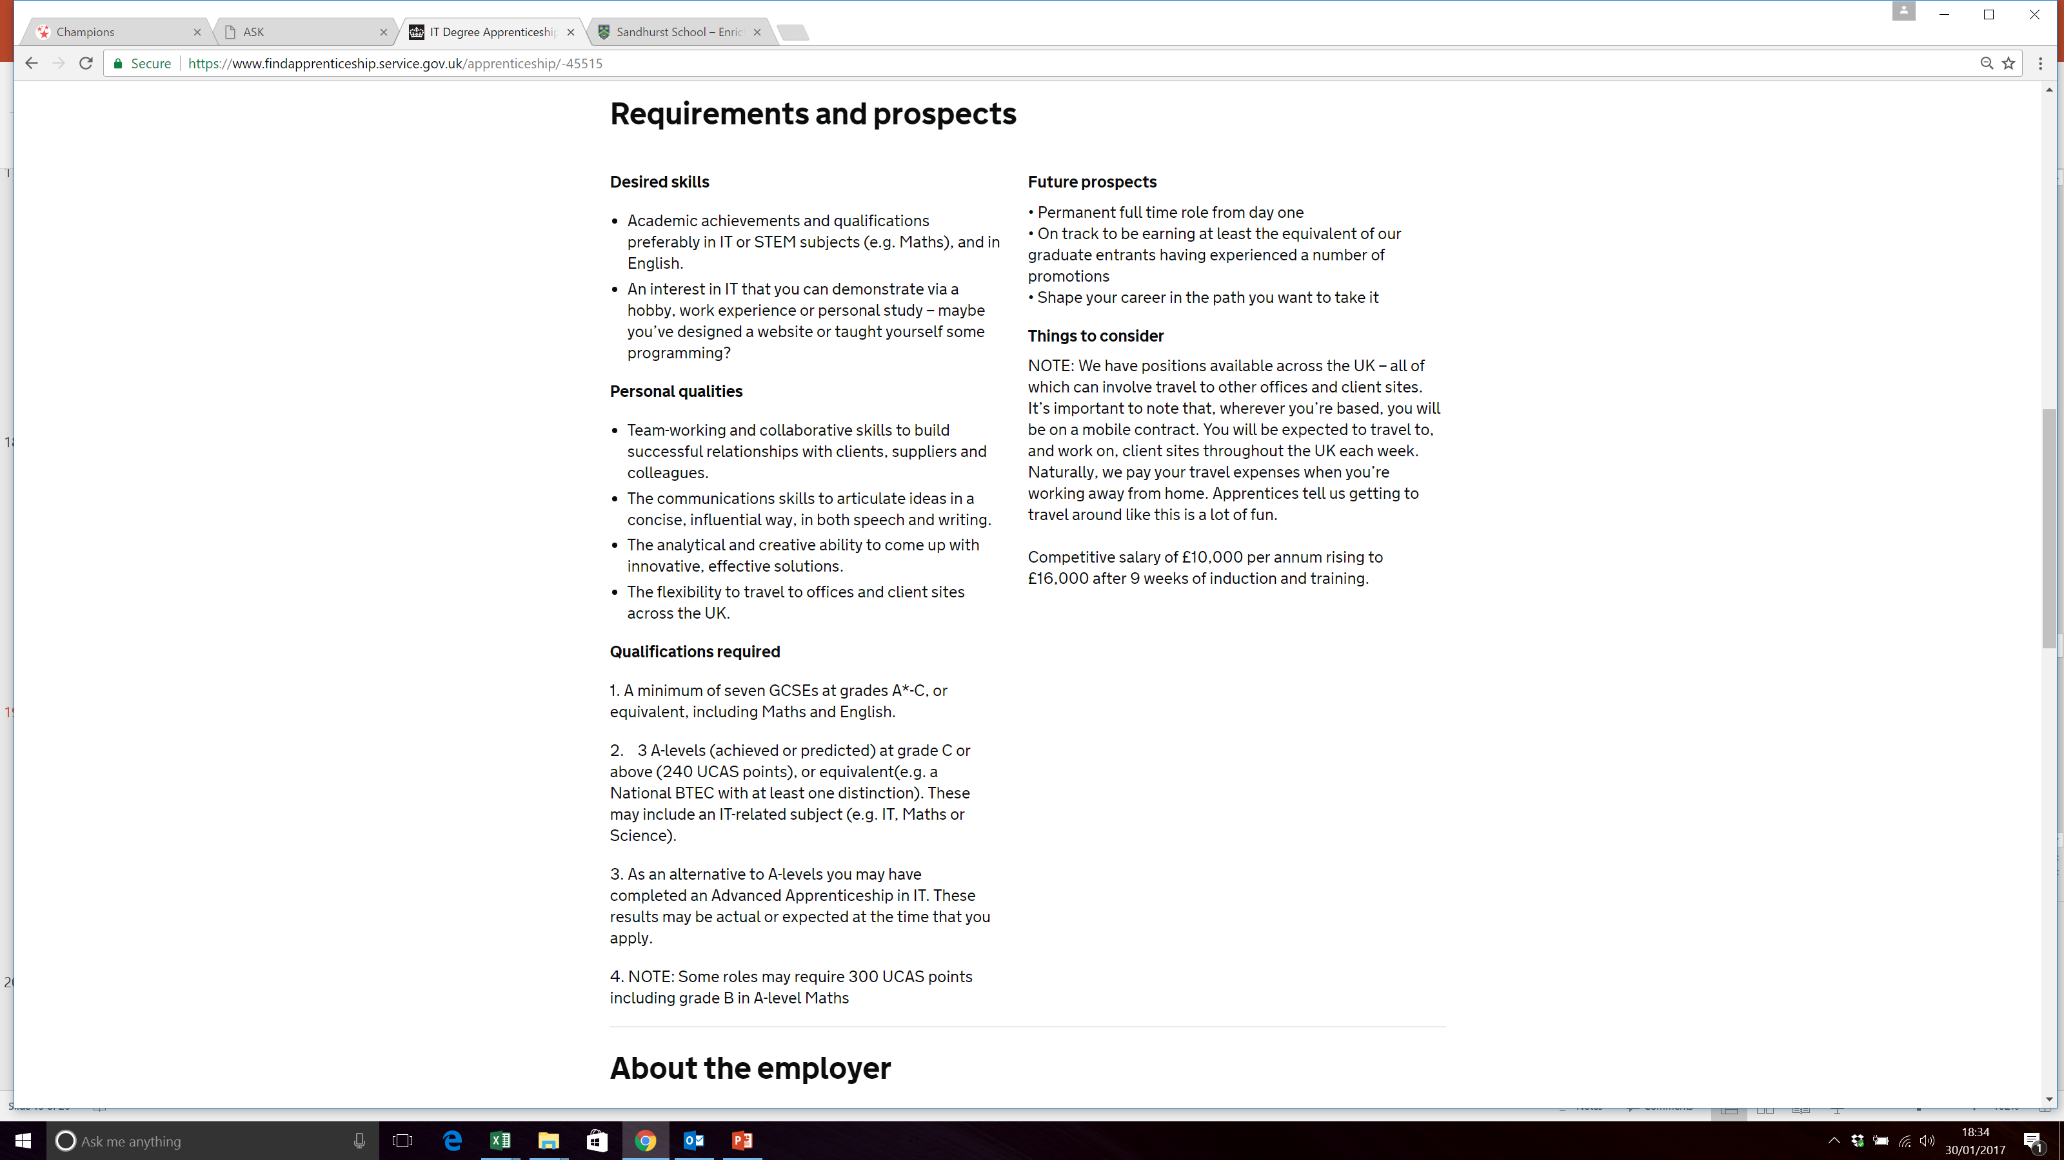

Slide 17
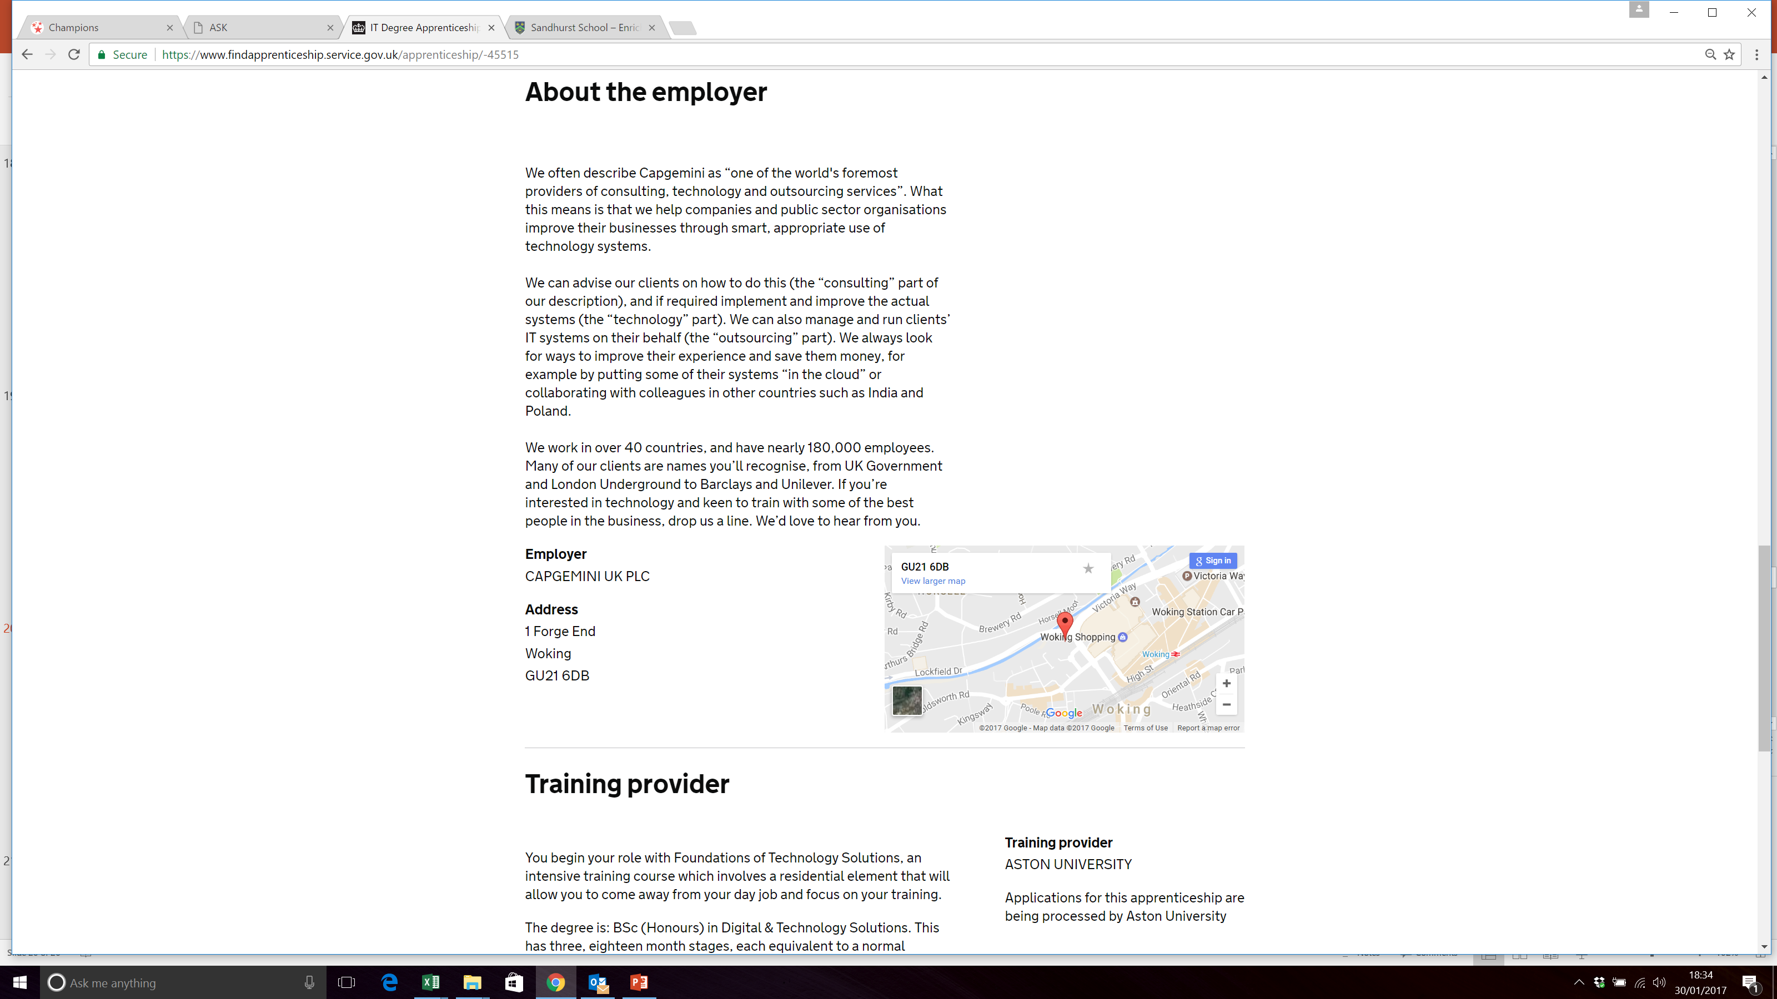

Slide 18

The Apprenticeship
Guide
Sophie to provide front cover
Find out about the latest apprenticeships available
Build your knowledge of starting salaries and progression opportunities
Read about real apprentices in real jobs

Slide 19
An apprenticeship is:
learn
Work
+ = apprenticeships
How many different types of apprenticeships job roles are there?
1500 job roles
How many apprenticeships are advertised on a daily basis?
28,000
What % of apprentices stay in employment at the end of their apprenticeship?
90%
What year at school must your complete before you can start an apprenticeship?
Year 11
What is the on-line system called where you can search and apply for apprenticeship jobs?
Find an apprenticeship
What must you do once you have been registered on ‘Find an apprenticeship’?
Activate the account
Nothing, it is free of charge
How much does it cost to register on Find an apprenticeship?

Slide 20

What next?
We can help!
We can run sessions for those in the Sixth Form who want help to search and apply for apprenticeships.
Speak to Mr. Cooper

Slide 21
Any questions?

